Slide 1

Planck
mission
All information and images in these slides can be found browsing through
http://sci.esa.int/planck/33333-summary/

Slide 2
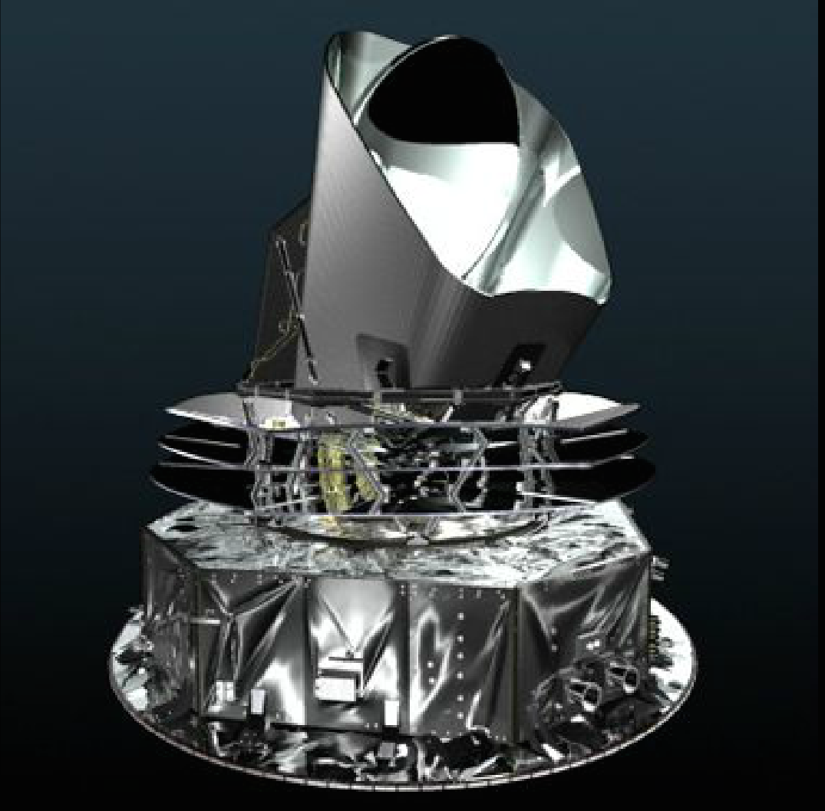

Slide 3
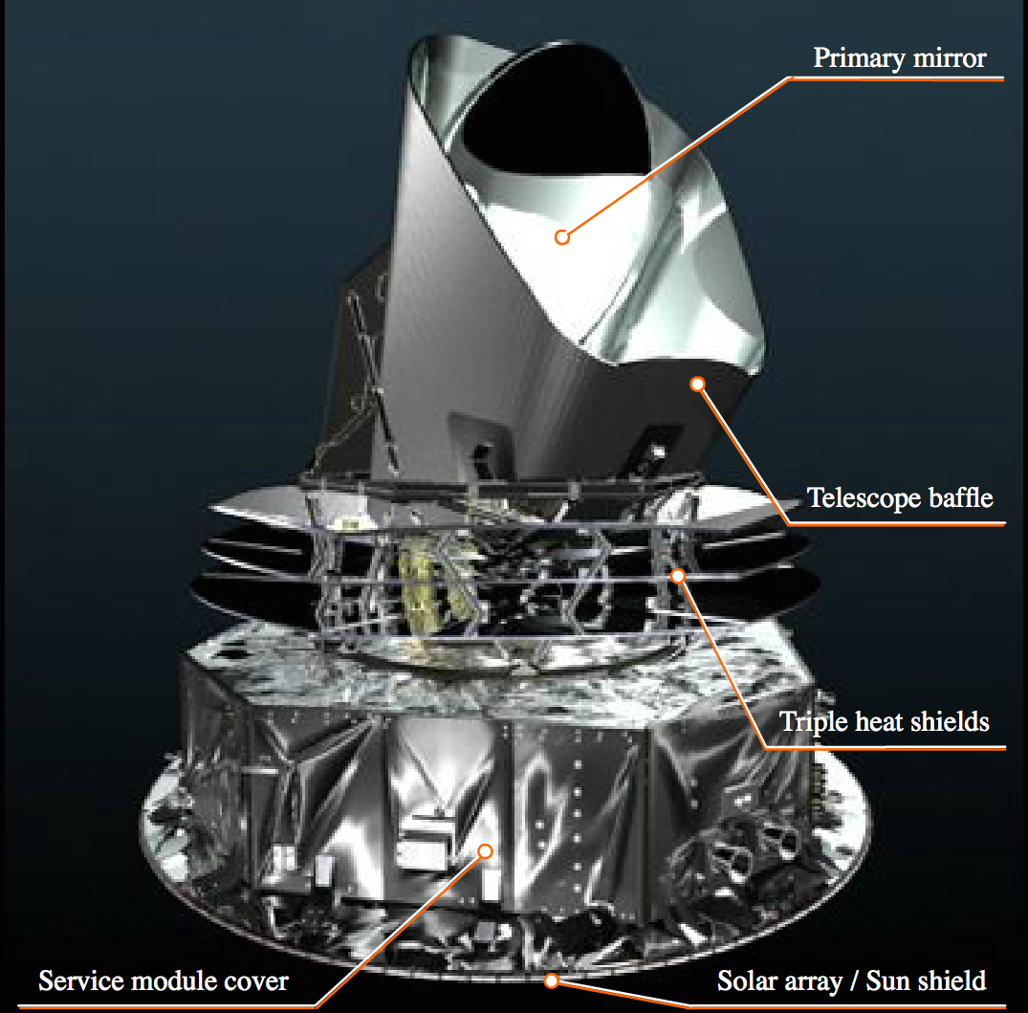

Slide 4
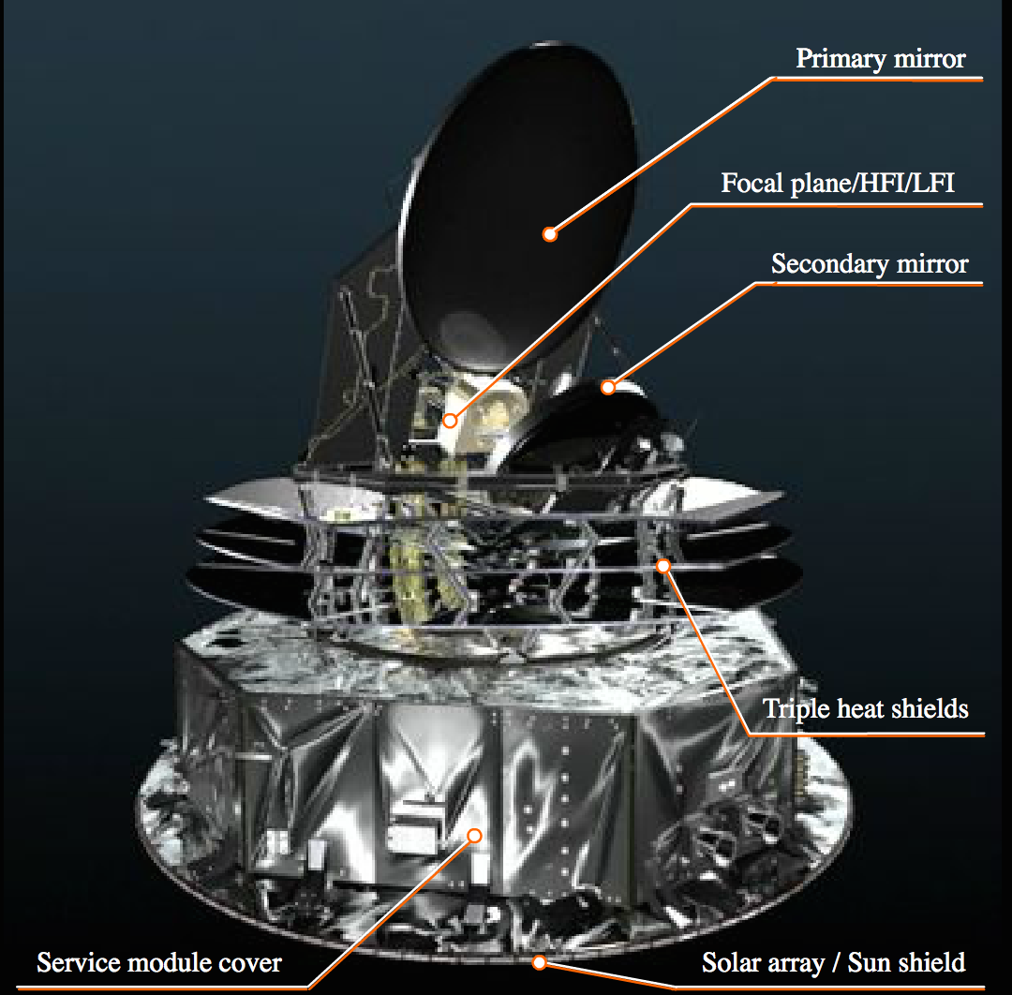

Slide 5
A portrait of the cosmos as a young Universe

Slide 6
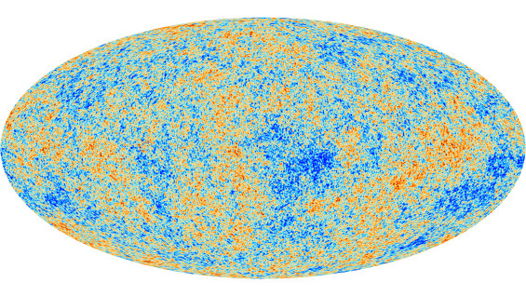
The Cosmic Microwave Background - as seen by Planck. Credit: ESA and the Planck Collaboration

Slide 7
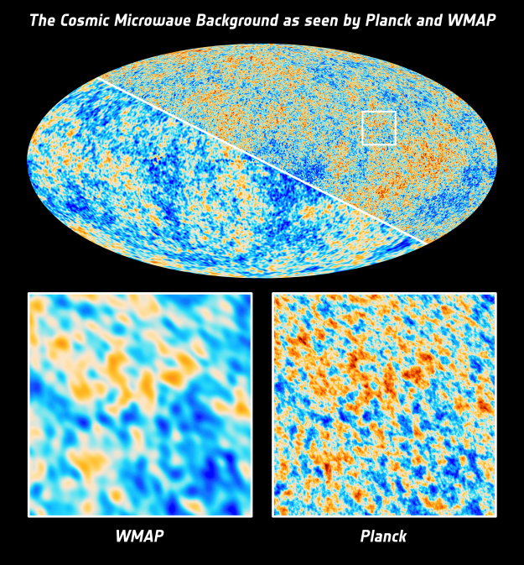
The Cosmic Microwave Background - as seen by Planck and WMAP.
Credit: ESA and the Planck Collaboration; NASA / WMAP Science Team

Slide 8
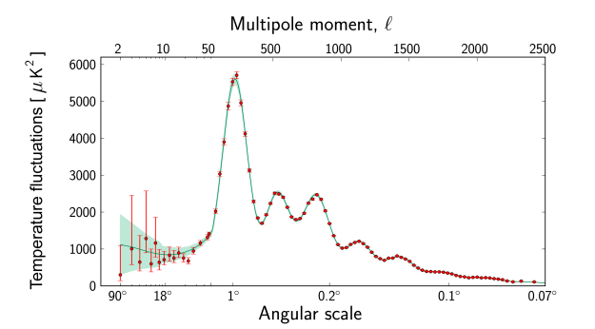
Planck's power spectrum of temperature fluctuations in the CMB
Date: 21 March 2013

Slide 9
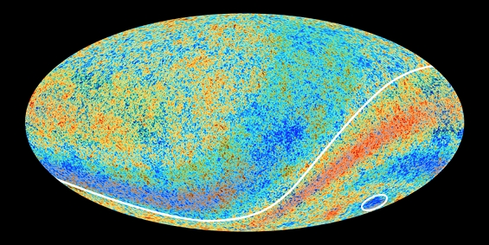
Hemispheric asymmetry and cold spot in the CMB
Planck’s anomalous sky: the hemispheric asymmetry and the cold spot.
Credit: ESA and the Planck Collaboration

Slide 10
Planck's exploration of the origin and growth of cosmic structure

Slide 11
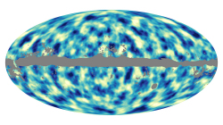
All-sky map of dark matter distribution in the Universe. Credit: ESA/Planck Collaboration

Slide 12
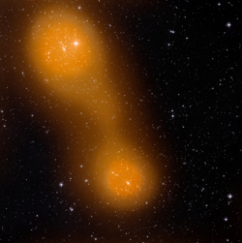
A bridge of hot gas between galaxy clusters Abell 399 and Abell 401. Credit: ESA & Planck Collaboration/ STScI Digitized Sky Survey

Slide 13
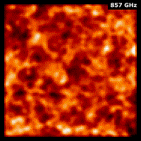
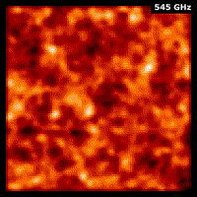
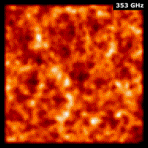
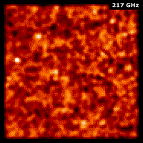
Cosmic Infrared Background fluctuations observed by Planck at various frequencies.
Credit: ESA/Planck Collaboration

Slide 14
Delving through the Milky Way with Planck

Slide 15
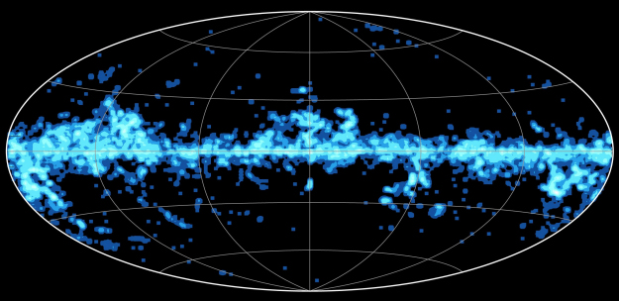
All-sky distribution of cold cores
All-sky image showing density of cold cores present in the Cold Core Catalogue of Planck Objects (C3PO)

Slide 16
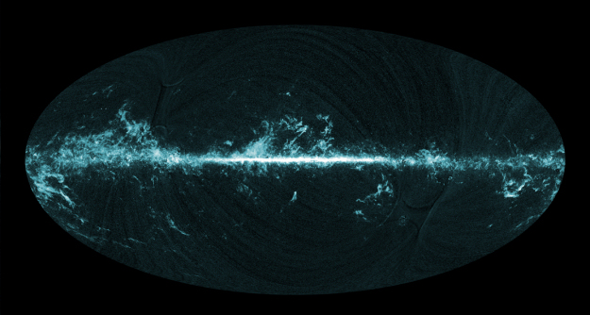
All-sky image of molecular gas seen by Planck

Slide 17
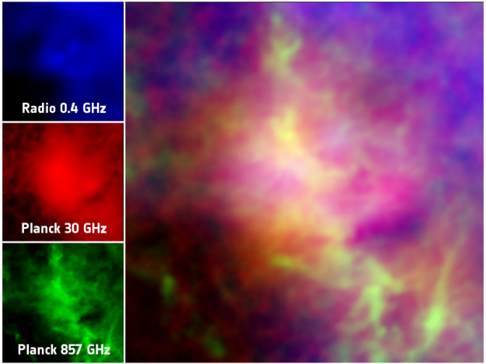
Anomalous dust emission in the Perseus molecular cloud

