Slide 1
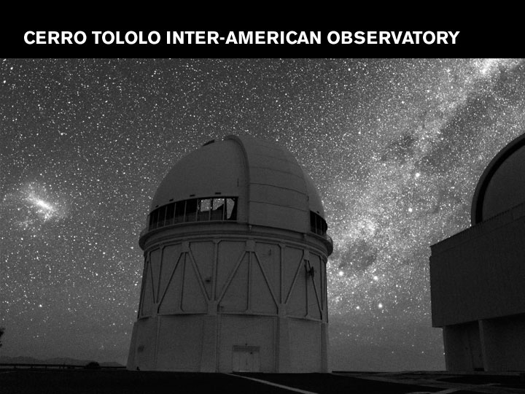
Black Hole Binaries in Quiescence
Charles Bailyn
Yale University, Yale-NUS College

Slide 2
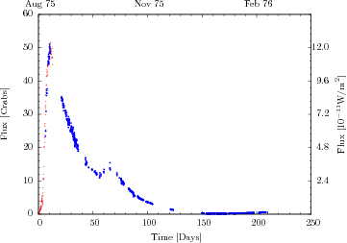
Transient X-ray Binaries
A0620-00
Coronado & Mendoza 2015
Quiescence
(decades)

Slide 3
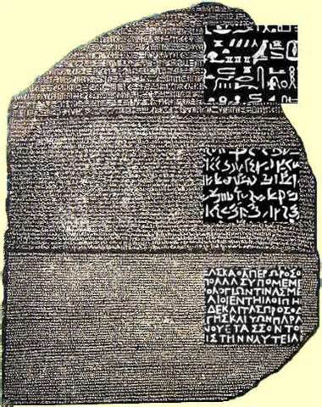
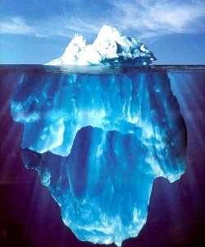
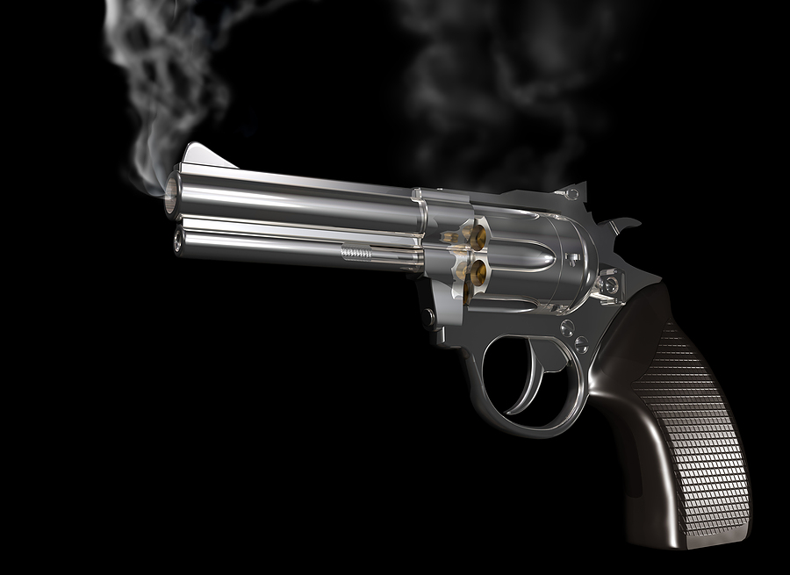
The Three Great Metaphors of Observational Astrophysics
Tip
“Tip of the Iceberg”
“Smoking Gun”
“Rosetta Stone”

Slide 4
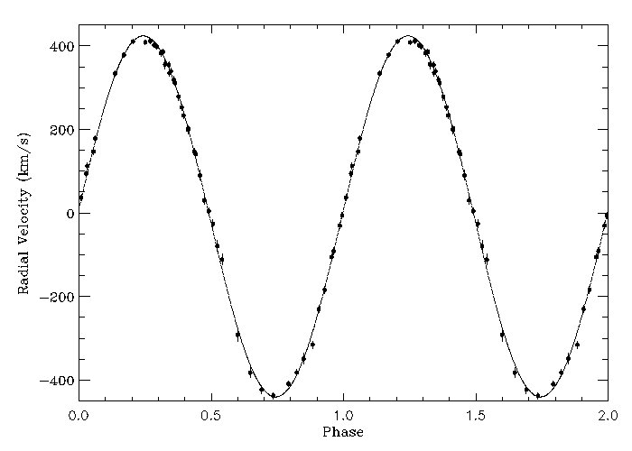
The “Smoking Gun”:
Dynamically Confirmed Black Hole Candidates
Neilsen, Steeghs & Vrtilek 2008: f=3.10 ± 0.04
A0620-00

Slide 5
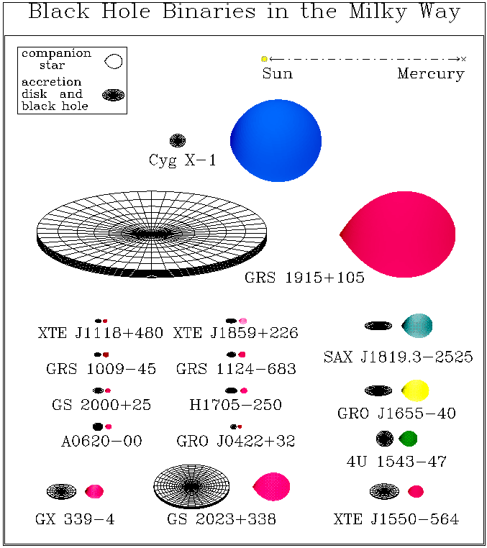
The “Smoking Gun”:
Dynamically Confirmed Black Hole Candidates
Courtesy
J. Orosz

Slide 6
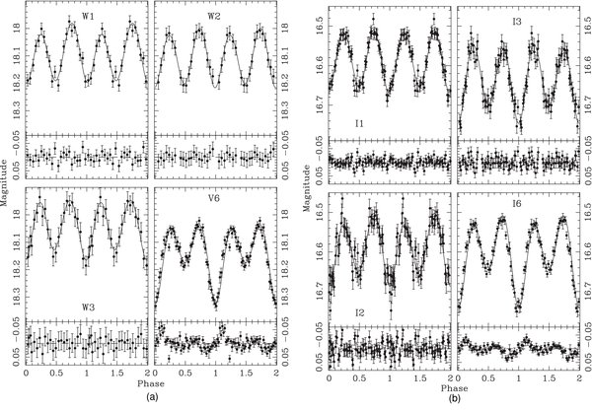
The “Smoking Gun”:
Dynamically Confirmed Black Hole Candidates
Some Dangers:
Phase Dependent Non-Stellar Light – Biased Inclinations
A0620-00 Cantrell et al. 2010

Slide 7
The “Smoking Gun”:
Dynamically Confirmed Black Hole Candidates
Some Dangers:
Phase Dependent Non-Stellar Light – Biased Inclinations A0620: 37-75 degrees from individual light curves But all compatible with 51 +/- 1 from consistent models
(Cantrell et al. 2010)
M and log(g) different from standard spherical stars: K5V in A0620 (dynamical): M=0.4M_{sun} R_{L}/R_{sun}= 0.7

Slide 8
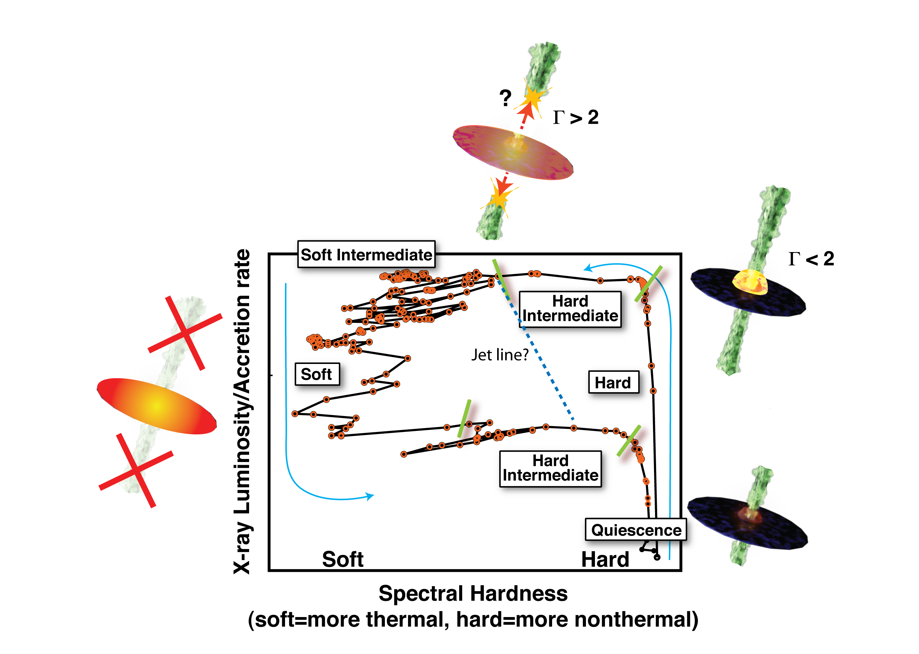
The “Rosetta Stone”:
Accretion/Outflow Connection
Outburst accretion states
  High/soft/thermal – disk dominated, little/no jet
  Low/hard/jet – X-ray powerlaw, significant radio
(from Sera Markoff)

Slide 9
The “Rosetta Stone”:
Accretion/Outflow Connection
Radio/X-ray correlation
  A “universal” key to disk/jet connection!
  Then multitracked and complicated
  Most points from two sources repeatedly observed
  A0620 moves perpendicularly to the correlation
Dincer et al. in prep
synchrotron
non-thermal

Slide 10
The “Tip of the Iceberg”:
Demographics of XRBs
XRBs are a key precursor class for gravitational wave sources – empirical demographics are key for use of LIGO as an astronomical facility
Transients with duty cycle >50 years recurrence time unavailable, so total numbers cannot be inferred
A0620 is an exception: archival optical data shows outburst in 1912
DIM mechanism predicts changes in accretion luminosity during quiescence. Can one infer recurrence time without awaiting another outburst?

Slide 11
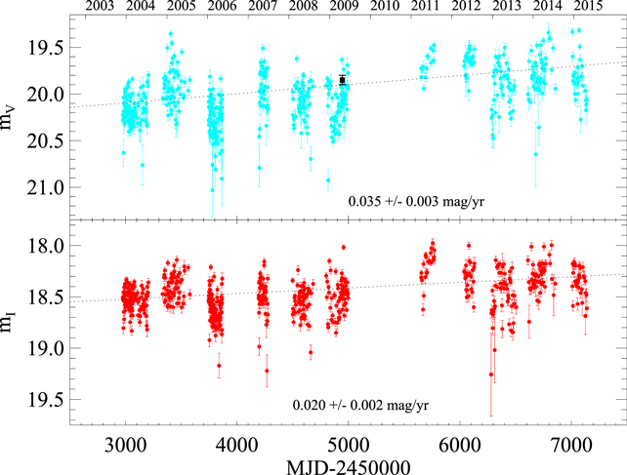
The “Tip of the Iceberg”:
Demographics of XRBs
SMARTS data of Nova Muscae: Wu et al. 2016

Slide 12
The “Tip of the Iceberg”:
Demographics of XRBs
A0620
SMARTS data 2003-2014

Slide 13
The “Tip of the Iceberg”:
Demographics of XRBs
A0620
SMARTS data 2003-2016

Slide 14
The “Tip of the Iceberg”:
Demographics of XRBs
Searching for XRBs in quiescence:
  Faint in all bandpasses – optical may be most promising
  Ellipsoidal lightcurve plus variable accretion component
  Hα emission; faint X-ray and radio counterpart
  Radial velocity curve indicates high mass (compact) companion
Won’t be easy!

Slide 15
Outburst Cycles: XRB vs AGN
XRB: assume that supply of mass is constant, and that variability is due to accretion flow instabilities
AGN: assume significant changes in mass supply (tidal disruption etc)

Slide 16
Outburst Cycles: XRB vs AGN
XRB: could mass supply vary?
  magnetic fields changing effective size of star
  3rd body
AGN: accretion flow instabilities and state changes (could dramatically affect demongraphics)

Slide 17
Questions? or
Lunch

Slide 19
The “Rosetta Stone”:
Accretion/Outflow Connection
Outburst accretion states
  High/soft/thermal – disk dominated, little/no jet
  Low/hard/jet – X-ray powerlaw, significant radio
Is quiescence a very low hard state?
  X-rays can be fit by hard power law (but low count rates)
  There is radio (but perhaps other explanations)
Narayan test for event horizons: lack of boundary layer leads to low L_{X} relative to neutron stars Most effective at low luminosity
Side note: L/L_{edd} for Sgr A* similar to A0620-00

Slide 20
The “Tip of the Iceberg”:
Demographics of XRBs
A0620
SMARTS data 2003-2014

Slide 21
The “Tip of the Iceberg”:
Demographics of XRBs
A0620: Phased 6-band data with stellar light indicated

Slide 22
The “Rosetta Stone”:
Accretion/Outflow Connection
Radio/X-ray correlation
  Originally thought to be “universal” – a key to disk/jet connection
  Then multitracked and complicated
  Most points from two sources repeatedly observed
  Very few low luminosity detections – not all simultaneous
A0620 simultaneous SED: Dincer et al. in prep
?
star
accretion
jet
synchrotron
non-thermal

