Slide 1
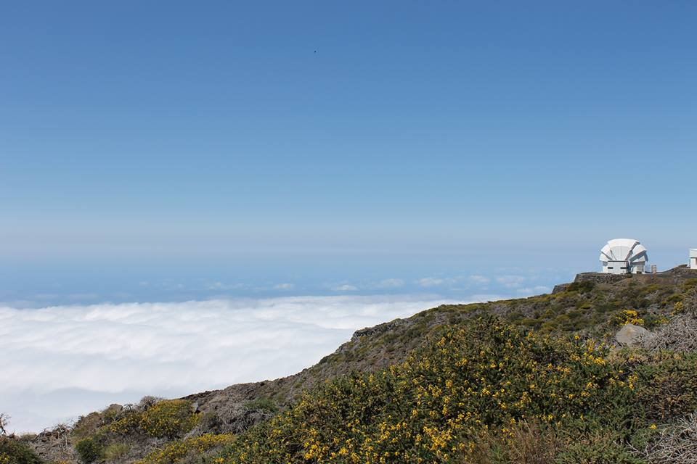
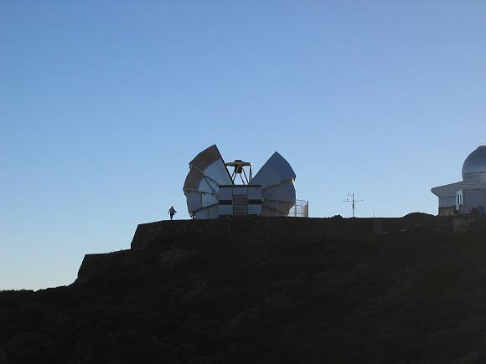
MOPTOP: Multi-colour Optimised Optical Polarimeter ^{1,2}Helen Jermak, ¹Iain A. Steele, and ¹Robert J. Smith
¹Astrophysics Research Institute, Liverpool John Moores University,Liverpool, UK. L3 5RF.
²Lancaster University, Bailrigg Campus, Lancaster, UK. LA1 4YW.
ABSTRACT
OPTIMAL PERFORMANCE
DESIGN
We present the design and science case for the Liverpool Telescope’s fourth-generation polarimeter; MOPTOP: a Multicolour OPTimised Optical Polarimeter which is optimised for sensitivity and multi-colour observations. Following the on-going success with the current polarimeter, Ringo3 (Arnold 2012), we introduce an optimised polarimeter which is limited by the photon counting efficiency of the detectors. Using a combination of CMOS cameras, a continuously rotating half-wave plate and a wire grid polarising beamsplitter, we can accurately measure the polarisation of sources down to 19th magnitude on a 2 metre telescope with much lower systematics (~0.1%) and variability timescales as short as a few seconds. This will allow accurate measurements of the intra-nightly variability of the polarisation of sources such as gamma-ray bursts and blazars (AGN orientated with the jet pointing toward the observer), allowing the constraint of magnetic field models revealing more information about the formation, ejection and collimation of jets.
The following requirements have been identified for MOPTOP:
• Maximum sensitivity, so the polarimetric accuracy obtained is defined only by the photon counting (Poisson) statistics of the light incident on the telescope.
• Very low systematic errors (< 0.1%) allowing measurement of low polarisation.
• Ability to measure a rapidly (~10 seconds) variable or fading source.
• Ability to measure all sources in the field of view without prior identification.
• Ability to measure sources over the widest possible dynamic range of photon counts and without prior knowledge of the source brightness.
• Ability to measure polarisation over different wavelength ranges simultaneously.
• Be available to respond to transient events and other targets of opportunity.
• The widest possible field of view (as limited by the telescope optics).
• The best possible spatial resolution (as limited by atmospheric effects).
The basic design of MOPTOP is shown below. The use of a half wave plate and a wire grid beam splitter, rather than a rotating polaroid as used in the previous Ringo polarimeters (Steele et al. 2006, 2010, Arnold 2012), allows almost double the amount of light to be recorded by the telescope and thus increases sensitivity.
MOPTOP is designed for use with the 2 metre fully robotic and autonomous Liverpool Telescope, located on Roque de los Muchachos, La Palma, Canary Islands (Steele et al. 2004).
Schematic Layout of ‘mini’-MOPTOP (the basic setup without the cameras) showing the principal components. The incoming white light beam from the telescope is indicated with solid, black lines. A continuously rotating half wave plate modulates the polarisation angle of the incoming beam. One polarisation state is transmitted (dashed line) and the other reflected (dotted line) by the beam splitter.
SCIENCE CASES
CONCLUSIONS
Linear polarisation is taking a lead role as a key diagnostic of physical conditions (for example magnetic field strength and geometry and relativistic plasma dynamics) in such transient sources as blazars, active galactic nuclei, X-ray binaries and gamma ray bursts (GRBs) (see Jermak et al 2016 for an example of studying linear polarisation in blazars).
As an example, use of polarimetry as a diagnostic tool in time domain programs has increased by a factor 5 on the Liverpool Telescope over the period 2012-2015.
In all of these high energy sources, polarisation allows astronomers to probe the physical conditions at spatial scales that will never be accessible to direct imaging observations.
For solar system sources such as asteroids and comets, the most important feature of a polarimeter is than it can measure low degrees of polarisation to an excellent accuracy (i.e is free from systematic errors). For comets, accurately measuring the polarisation strength can map the structure of a comet from the solar light scattered by dust particles in the coma. The linear polarisation depends on the intrinsic properties of the dust particles (their size, structure and composition) and also on their spatial distribution. The wider views of polarised light in the coma provide a study of the dust population distribution not available to the point sample, in situ measurements found by spacecraft such as the ESA Rosetta mission. Scattering is strongly wavelength dependent, making a
multicolour approach important.
For GRBs the optical afterglow of the fireball fades on timescales of minutes (Piran et al. 1999), therefore both a rapid response and an observing approach that gathers maximum information in the time available is essential. This implies the need for maximum sensitivity combined with simultaneous, multicolour capability.
We have presented a unique combination of CMOS cameras, a continuously rotating half-wave plate and a wire grid polarising beamsplitter to create a multicolour, optimised polarimeter which utilises 100% of the incoming light. We are in the process of creating the basic setup of ‘mini’-MOPTOP which will test the simultaneity of
two CMOS cameras (see SPIE paper Steele et al. 2016, poster [9915-76]) and from the initial findings of blazar monitoring in three wavelength bands using the Ringo3 polarimeter we envisage the new polarimeter to have at least 3 wavebands.
In the future we also plan to explore the possibility of an additional circular polarisation (CP) measuring mode using a quarter wave plate to measure whether optical CP is present, in particular, in blazars. Measurements of CP in these sources would put tight constraints on the magnetic field conditions of these sources.
The instrument will have deployable dichroic mirrors which can be used to split the light to multiple pairs of cameras.
Investigations using colour magnitude diagrams of blazar sources (see Jermak PhD thesis 2016) showed that use of data from the same camera on the x and y axes produce false correlations. This analysis requires data from at least three cameras (see poster [9915-76] for sCMOS experiments).
Design for use on the LT but reproducible for other telescope facilities.
Two modes : sensitivity (through one broadband optical filter to one camera) or multicolour observations in three cameras.
REFERENCES
Piran, T., PhysRep, 314 , 575–667 (1999).
Steele, I. A. et al., SPIE, 5489, 679, (2004).
Arnold, D. et al., SPIE, 8446, 2, (2012).
Steele, I. A., et al., SPIE, 6269, (2006).
Steele, I. A. et al., SPIE, 7735 (2010).
Jermak, H. E., et al, MNRAS, subm. (2016).
Poster [9908-169]
telescope.livjm.ac.uk

Slide 2
The following requirements have been identified for MOPTOP:
• Maximum sensitivity, so the polarimetric accuracy obtained is defined only by the photon counting (Poisson) statistics of the light incident on the telescope.
• Very low systematic errors (< 0.1%) allowing measurement of low polarisation.
• Ability to measure a rapidly (~10 seconds) variable or fading source.
• Ability to measure all sources in the field of view without prior identification.
• Ability to measure sources over the widest possible dynamic range of photon counts and without prior knowledge of the source brightness.
• Ability to measure polarisation over different wavelength ranges simultaneously.
• Be available to respond to transient events and other targets of opportunity.
• The widest possible field of view (as limited by the telescope optics).
• The best possible spatial resolution (as limited by atmospheric effects).

