Slide 1



The nature of relativistic jets produced when a star falls into a BH♪
Pawan Kumar
Outline†
•
TDEs: summary of relevant observations
•
Radiation process for TDE jets and jet composition
♪Rodolfo Barniol Duran, Patrick Crumley, Wenbin Lu
IAUS 324, Ljubljana, Sep 13, 2016
Notes:
Accelerator Cost (to 30% accuracy) ≈ $2B x [(Length/10km)^1/2 + 5×(Energy/TeV)^1/2 + (Power/100MW)^1/2] ; from Shiltsev, JINST, 9, T07002 (2014); LHC cost $9B. The highest energy cosmic ray detected is ~10^12 GeV, which is 10^3 TeV CoM energy for colliding with protons in the atmosphere. The CoM energy for LHC is ~12 TeV. So cosmic rays are 100 times more energetic than LHC for exploring high energy collisions; however cosmic ray flux is much lower than LHC beam luminosity of 2x10^33 particles/cm^2/s. The circumference of LHC is 27 km.

Slide 2
Questions about BH jets that have been around for ~ 40 years
How are high-energy photons produced (synchrotron, SSC or something else?) and particles accelerated?
What are jets made of?
How are jets launched, powered and collimated?

Slide 3
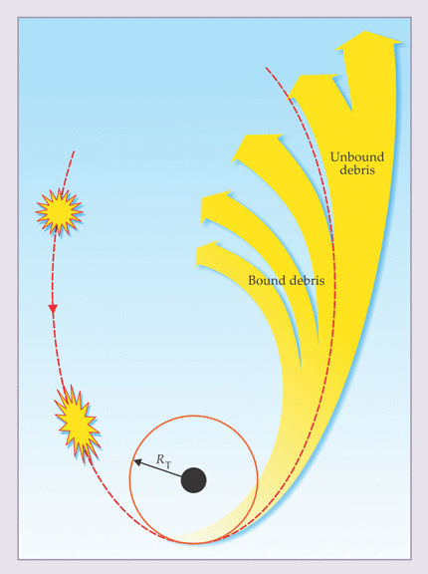
Roughly 10% of TDEs, and these events are excellent for answering some of these long standing questions, because:
•
they are extremely bright, so we can collect high quality, multi-wavelength, data & variability time can be accurately measured to constrain the size of system.
•
we know how much mass falls into the black hole♩, and hence we know the total energy budget for the event.
•
the jet is transparent at the launching site (because of the large Schwarzschild radius of massive BHs) so we can see the entire jet.
♩ One of the TDE candidates with jet is at the center of an elliptical galaxy where stars have mass ~ 1 M
The BH at the center of Milkyway swallows a star once every ~10⁵ years.
Notes:
Super-massive BHs probably gain ~10⁶ M_{sun} by capturing stars over the Hubble time --- which is a few percent of their mass; a minor (but important) contribution to their total mass.

Slide 4
Optical depth of relativistic jets
✪
For a baryonic jet of isotropic luminosity L_{iso} the optical depth at radius R is:
σ_{T} L_{iso}
τ =
––––––––––
4πR m_{p} c³ Γ³
✪
Expressing L_{iso} & R in terms of the Eddington luminosity (L_{E}) & Schwarzschild radius (R_{s}) we find
L_{iso}
R_{s}
1
τ =
–––
–––
–––
L_{E}
R
Γ³
For narrow jets L_{iso}/L_{E} >>1, and so the jet can be optically thick at the launching radius unless Γ>>1.
(Wind from the accretion disk can also keep the jet hidden up to a large radius unless the jet is pointing directly at us.)

Slide 5
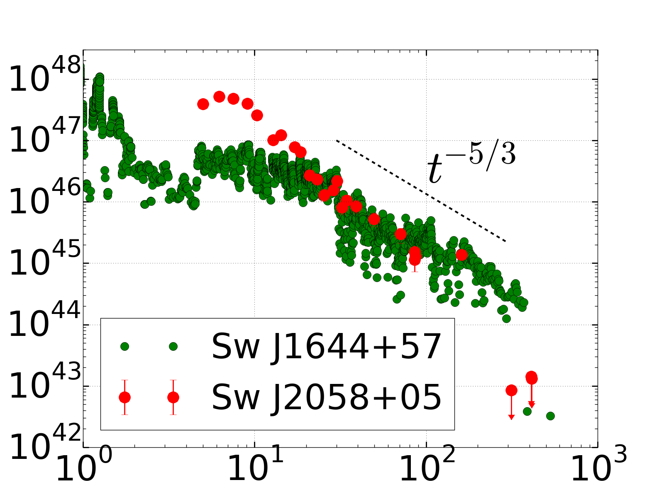
X-ray light-curves of TDEs with jets
10-10² L_{edd}; cδt ~ 10 R_{g}
L_{X} [egs/s]
Burrows et al. (2011); Cenko et al. (2012)
t (days)

Slide 6
X-ray light-curves of TDEs with jets
10-10² L_{edd}; cδt ~ 10 R_{g}
L_{X} [egs/s]
Burrows et al. (2011); Cenko et al. (2012)
Spectrum is a simple power-law function from 0.3 – 10 keV: f_{ν} α ν^{-0.8}
f_{ν}
f_{ν} α ν^{-0.8}
t (days)
10 μJy
1
ν (keV)
10

Slide 7
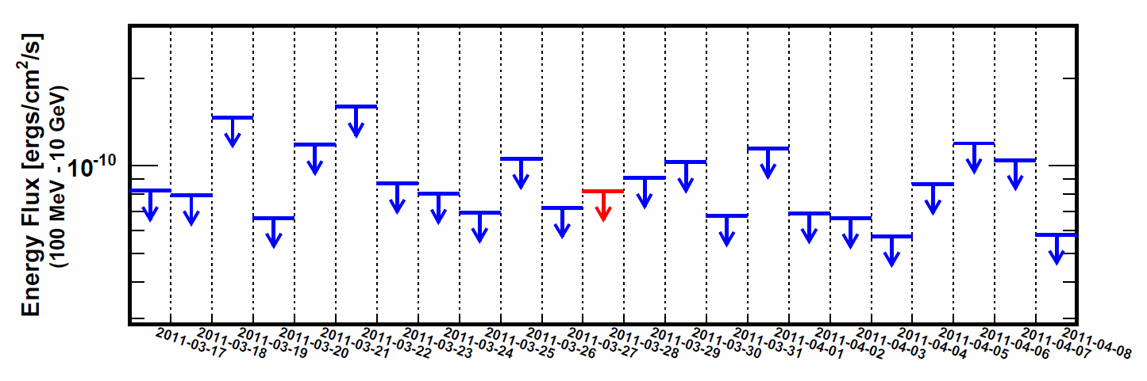
Swift J1644+57: γ-ray data
Fermi/LAT upper limits on the 100 MeV- 10 GeV integrated flux of 3x10⁻¹¹ erg/cm²/s (L_{LAT} < 10⁴⁶ erg/s)
Veritas upper limits at 500 GeV ~ 10⁻¹⁰ erg/cm²/s (L_{ver} < 10⁴⁵ erg/s)
Burrows et al. (2011)

Slide 8
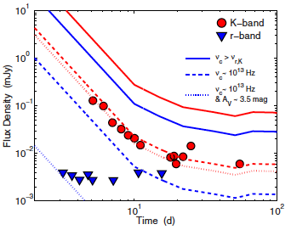
Swift J1644+57: optical/IR data
Infra-red K-band data are extremely constraining of jet properties.
Levan et al. 2011

Slide 9
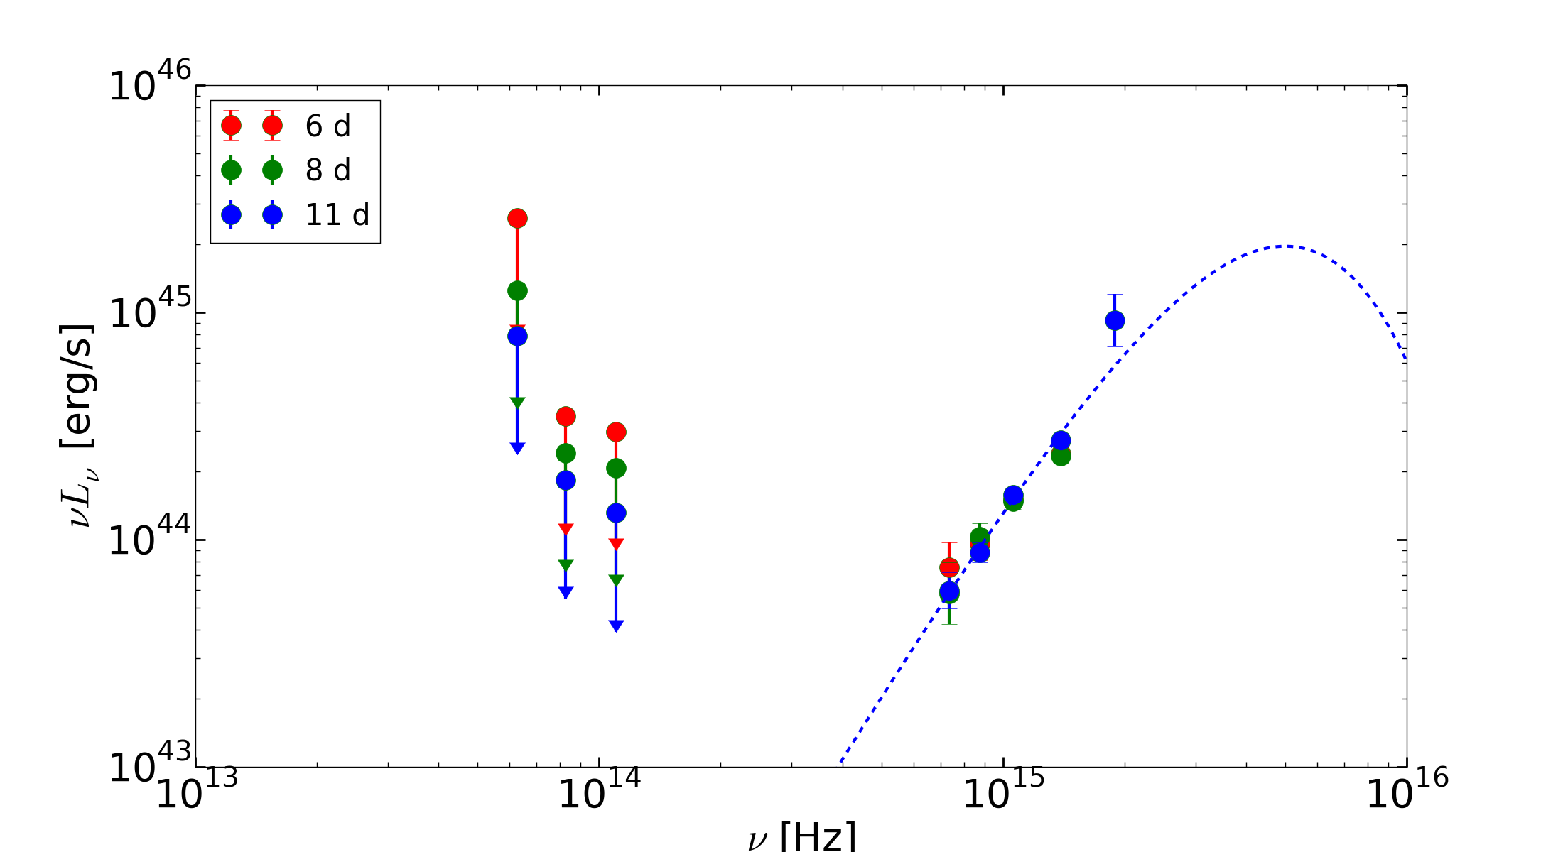
External photon field (opt-UV)
1/2
2
R_{ph} ≈ 10¹⁵ cm L₄₅/T₅ ~ 10³ R_{g}
•
Wind with M ~ a few M/yr ~ 10² L_{Edd}/c²
Swift J 2058+05
L_{ν} α ν²
T ≥ Tmin

Slide 10
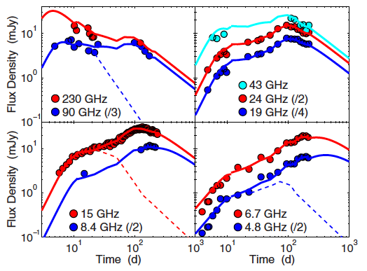
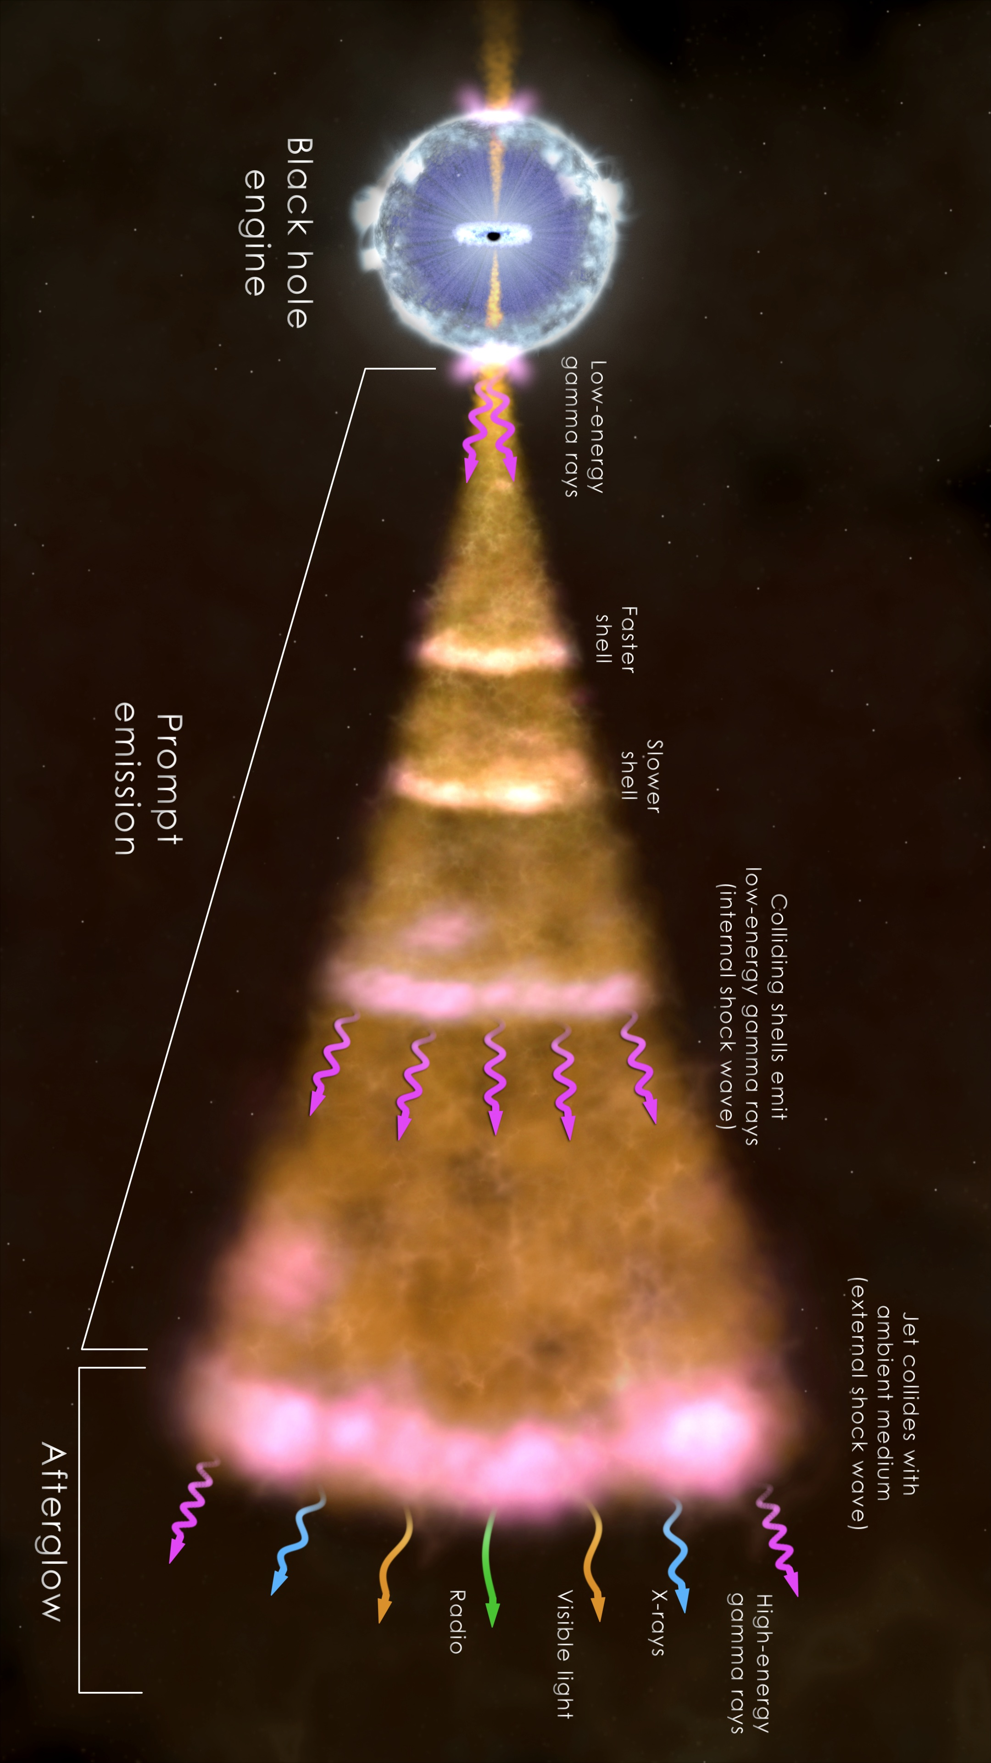
Swift J1644+57: radio/mm data
Consistent with being the afterglow of a mildly relativistic jet.
Berger et al. 2012
Notes:
Only say that mm photons are produced by the synchrotron process when the jet runs into the medium in the vicinity of the BH.

Slide 11
March 25, 2011 event (Swift J1644+57)
X-ray photon generation mechanism
And Jet composition & particle acceleration
The basic strategy is to assume that the jet is
Either baryon or Poynting flux dominated & calculate radiation from it, and confront that with data
shock radiation
Black hole,
accretion disk & jet
Relativistic jet
Jet energy dissipation
and X-ray generation

Slide 12
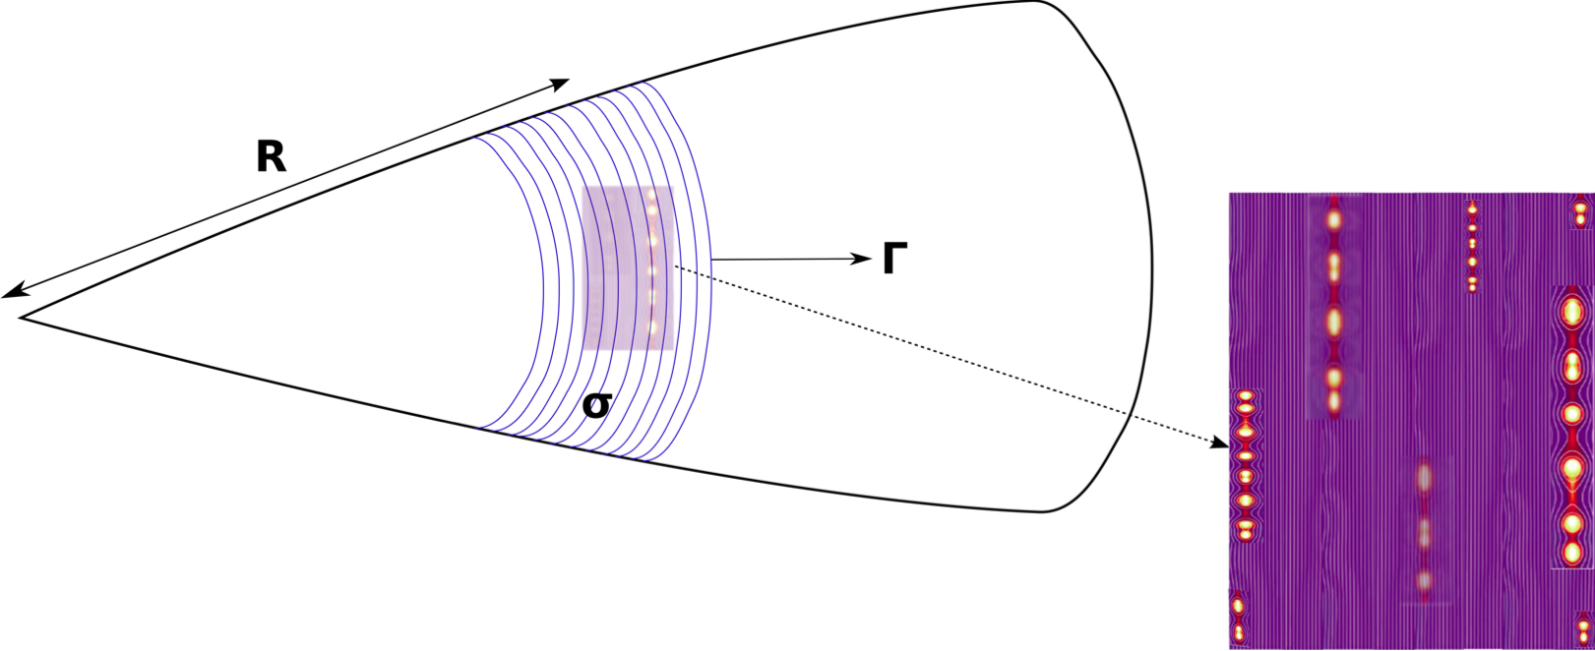
Baryonic jets
Jet KE is converted to particle energy via shocks and the Fermi acceleration mechanism is at work.
Electrons are accelerated near the shock front, and once they leave the acceleration region they cool down due to radiative loss.
Poynting jet
Jet magnetic energy converted to particle energy in current sheets (magnetic reconnections).
Electrons continually accelerated over an extended period
Kumar & Crumley, 2015
Notes:
The only thing to say for this slide is that → electrons can be continuously accelerated in Poynting jet BUT NOT in a baryonic jet.

Slide 13
There are many different radiative processes we need to consider for generating X-ray photons:
•
Synchrotron (non-thermal spectrum)
•
Synchrotron + inverse-Compton (SSC)
•
Thermal photons (Planck spectrum) produced in the jet and inverse-Compton scattered to higher energies.
•
Photons from the accretion disk/wind inverse Compton scattered by electrons in the jet
And confront these with IR to γ-ray data to figure out jet composition & particle acceleration.
The bottom line is that the only way we can explain the data is if the jet energy is carried by magnetic fields & particles accelerated in current sheets.

Slide 14
Constraints on radiation mechanism
Variability time <10²s.
Source must be at R > R_{s} (∼2x10¹¹ M_{BH,6} cm).
The jet Γ ∼ 10 (from mm/radio data & total energy constraint).
X-ray luminosity ∼3x10⁴⁷ erg/s for a duration of ∼10 days requires an efficiency >1% to avoid an unphysically large amount of energy.
Energy flux below the X-ray band should decrease as ∼ ν^{1/3} (or faster) otherwise the IR flux would be larger than the observed value.

Slide 15
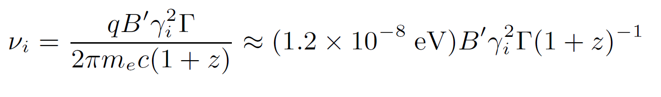
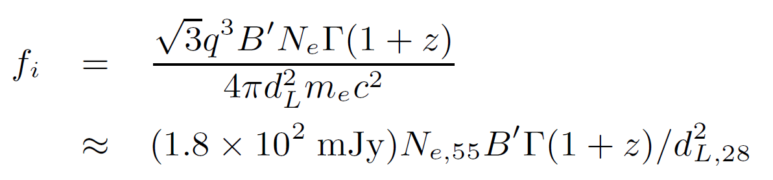
Synchrotron Radiation Process
•
B
  An electron with a Lorentz factor γ_{i} traveling through a magnetic field of strength B’ in a jet moving at bulk Lorentz factor Γ radiates at a frequency ν_{i}:
•
>
γ_{i}
•
We add up the contributions of N_{e} electrons to produce the total observed flux at ν_{i}
In other words, we can find the total number of electrons in the jet from the observed flux (and known distance).

Slide 16
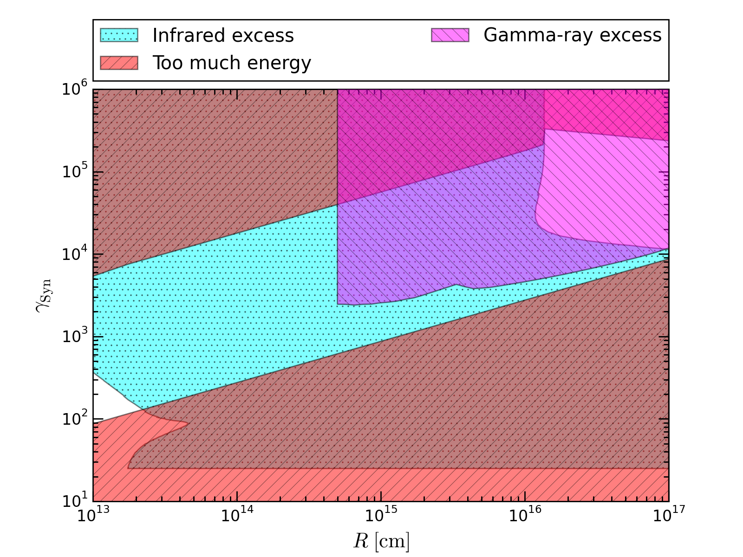
Synchrotron solution space for Baryonic jet
Lorentz factor of electrons (γ_{e})
Cumley, Lu, Kumar et al. (2016)
Distance from the BH (cm)
Notes:
Skip this slide if running out of time --- or at best make the point that the entire distance-gamma_e parameter space is ruled out.

Slide 17

Synchrotron + inverse Compton
  The Thomson scattering optical depth of the jet is:
  τ_{T} = N_{e} σ_{T}/(4πR²)
❖
  For electrons with Lorentz factor γ_{e} the inverse-Compton scattered photon frequency and flux can be related to the synchrotron photon frequency and flux as
ν_{s}γ_{e}²
ν_{IC} ≈ γ_{e}² ν_{s} , f_{ν,ic} ≈ τ_{T} f_{νs}
ν_{s}
  The electrons will cool due to this process –
γ_{e}
R₁₄² Γ₁²
t’_{c} ~ 120 s
_______
γ_{e} L_{x,47}
This time should not be less than the dynamical time, otherwise excessive IR emission will be produced.
Notes:
Synchrotron photons (or seed photons) have energy of a few eV which are then boosted by scattering off of electrons to keV.

Slide 18
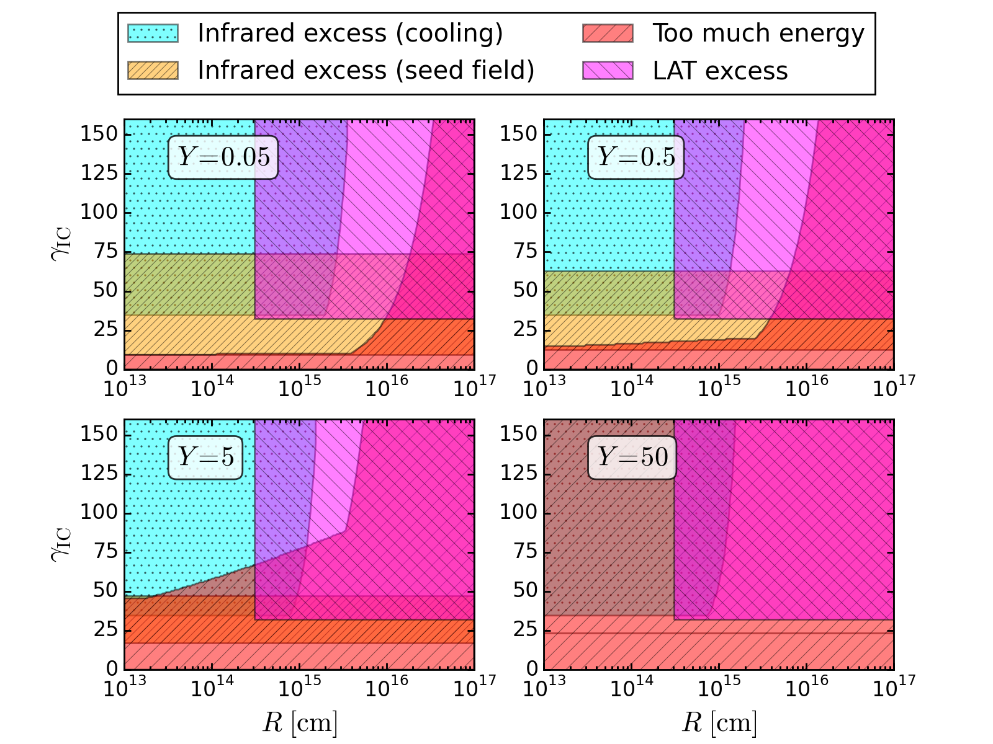
Cumley, Lu, Kumar et al. (2016)
Internal inverse-Compton solution space for Baryonic jet

Slide 19
Synchrotron + inverse Compton
  Let us consider electrons with Lorentz factor γ_{e} and Thomson scattering optical depth of the jet is:
  τ_{T} = N_{e} σ_{T}/(4πR²)
❖
  The inverse-Compton scattered photon frequency and flux can be related to the synchrotron photon frequency and flux as
ν_{s}γ_{e}²
Ruled Out
ν_{IC} ≈ γ_{e}² ν_{s} , f_{ν,ic} ≈ τ_{T} f_{νs}
ν_{s}
  The electrons will cool due to this process –
γ_{e}
R₁₄² Γ₁²
t’_{c} ~ 120 s
_______
γ_{e} L_{x,47}
This time should not be less than the dynamical time, otherwise excessive IR emission will be produced.
Notes:
Synchrotron photons (or seed photons) have energy of a few eV which are then boosted by scattering off of electrons to keV.

Slide 20
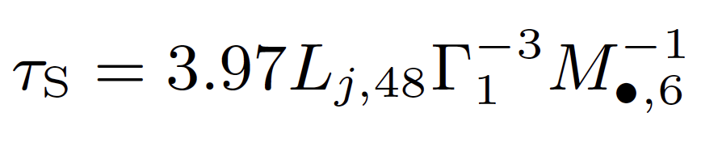
Thermal Emission + inverse-Compton
Small optical depth even at the base of the jet, makes it very difficult to reprocess spectrum
At late times when the flux is decreasing ∝ t^{-5/3}, the spectrum hardens, opposite of the expected behavior of photospheric radiation.
Ruled Out
So multiple IC scatterings below photospheric is unlikely to be responsible for the observed X-rays.

Slide 21
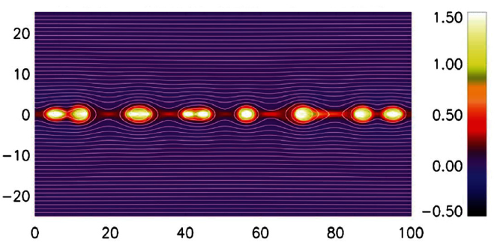
Synchrotron Radiation from Poynting Jet
Works, because electrons are continuously accelerated in current sheets
Black hole,
accretion disk
dissipation of jet magnetic field
Able to avoid infrared excess because electrons are not able to cool to energies where they would produce IR.
Energy requirement is much more reasonable since we need fewer protons/electrons as all electrons in reconnection zones radiate in the X-ray band.

Slide 22
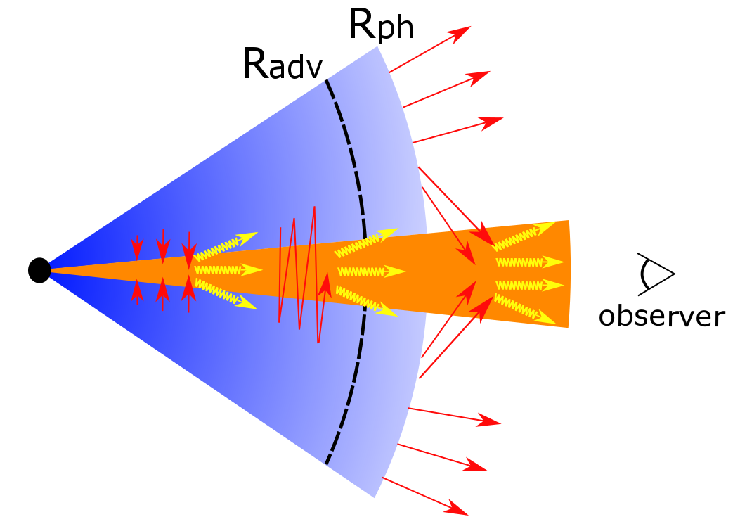
External IC radiation mechanism: basic picture
~ 10³ R_{g}
Optical-UV photons
Jet Γ ~ 5-10
L_{eic} ≈ L(T) τ_{j} (Γγ)²
~ 10 - 10³ L
ε_{eic} ≈ ε(T) (Γγ)²

Slide 23
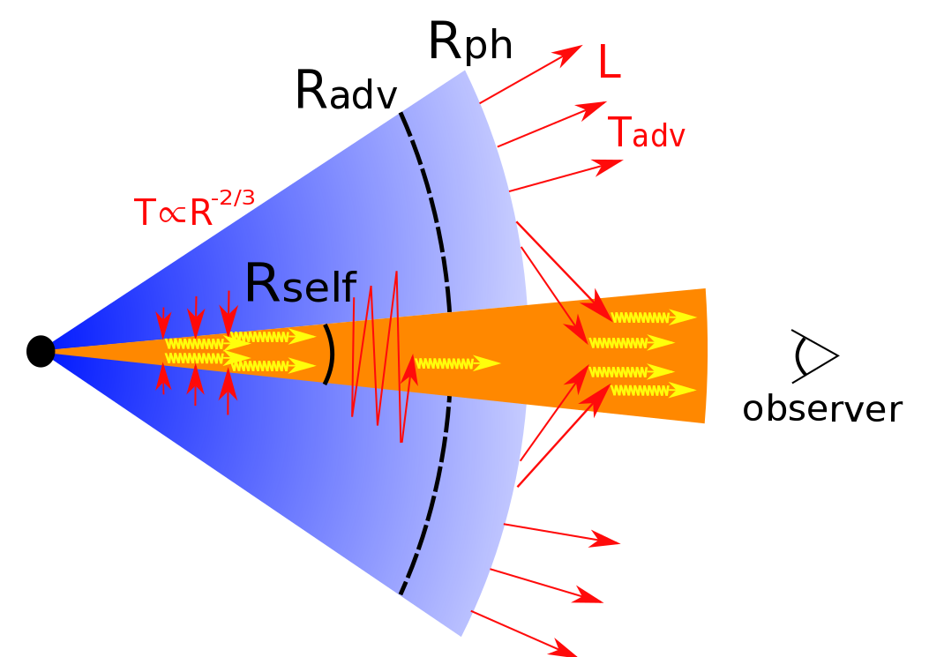
IC above and below the photosphere
Above photosphere:
L_{eic} ≈L(T) τ_{j}(Γγ)²
ε_{eic}≈ε(T) (Γγ)²
Below photosphere:
L_{eic}≈L(T_{adv}) 2(Γγ)²/θ_{j}
ε_{eic}≈ε(T_{adv}) (Γγ)²
Exceeds the observed L_{x}!

Slide 24
Mildly relativistic wind can solve this problem
Relative Lorentz Factor: Γ_{r} = Γ_{j} Γ_{w} (1 – β_{j} β_{w})
Above the photosphere
L_{eic} ≈ L(T) τ_{j} (Γ_{r} γ)² /Γ_{w}²
ε_{eic} ≈ ε(T) (Γ_{r} γ)²
Below the photosphere
Γ_{w} ~ 1.5 (L_{w} ~ 10⁴⁶ erg s⁻¹) can prevent L_{eic} from getting too large below the photosphere
L_{eic} ≈ L(T_{adv}) 2θ_{j}⁻¹(Γ_{r} γ)²/f(Γ_{w})
ε_{eic} ≈ ε(T_{adv}) (Γ_{r} γ)²
f(Γ_{w}) = (1 - β_{w}/3)(1 + β_{w})³ Γ_{w}²
❖
Power-law electron Spectrum needs to be maintained to produce F_{ν} ~ ν^{-α} (α ≈ 0.7) between 0.3 and 10 keV: N_{γ} ~ γ^{-p} with p ~ 2.4
❖
Because of the short IC cooling time, electrons need to be continuously accelerated, and that again suggests a Poynting jet.

Slide 25
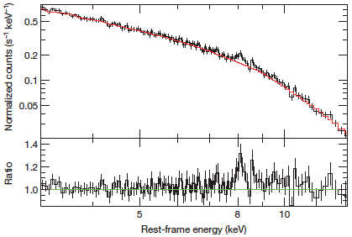

J1644+57 Fe K_{α} line (Kara et al. 2016, Nature); v~0.15c (blueshift)

Slide 26
Here is what we have found:
A good fraction of star’s mass is converted to energy (E ~ m* c²) – in the form of a relativistic jet
Piecing the data together we conclude that the jet energy is most likely transported as Poynting flux – particle KE dominated jet is not completely ruled out (one scenario can be made to work).
Magnetic field is dissipated at ~10¹⁵ cm from the BH and e⁻ accelerated to ~TeV, and p⁺ to at least ~10¹⁸ eV; X-rays produced by the synchrotron process

Slide 27
Reprocessed infrared radiation from TDEs
E_{rad} ~ 10⁵¹ – 10⁵² erg & Δt ~ 10⁶ – 10⁷ s
Ionize Hydrogen (and photo-dissociate H₂)
Heat up dust
If no dust extinction,
M_{ion} ~ mp E_{rad}/25 eV ~ 10⁴ M E_{rad,51.5}
R_{ion} ~ 2.6x10¹⁹ cm (E_{rad,51.5}/n₃)^{1/3}
(t_{rec} ~ 10³/n₃ yr)
2/3
1/3
N_{H} = nR_{ion} = 2.6x10²² n3 E_{rad,51.5} cm⁻²
1/3
A_{v} ~ 14 n₃ E_{rad,51.5} mag
2/3
Notes:
If the galactic center is dusty then the dust extinction opacity will prevent H, H₂ and He ionization at radius > 1 pc, and the bulk of the UV radiation from the TDE will be processes by dust and re-emitted in IR

Slide 28
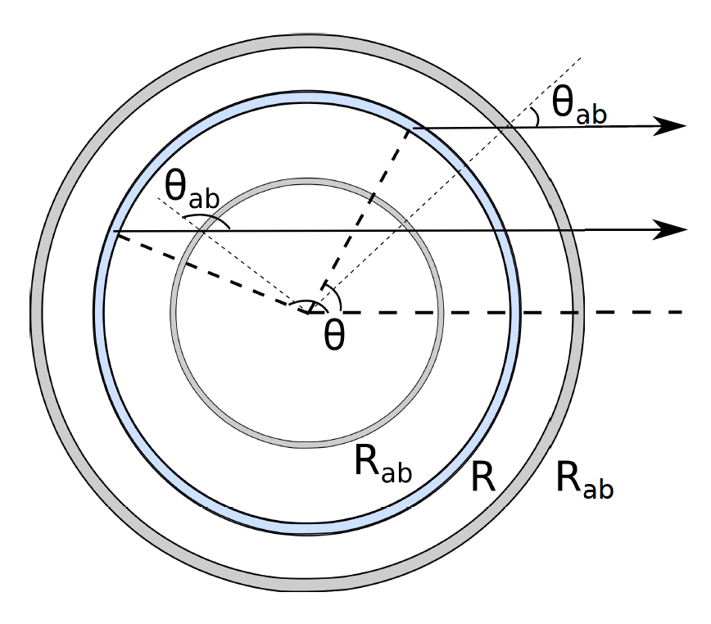
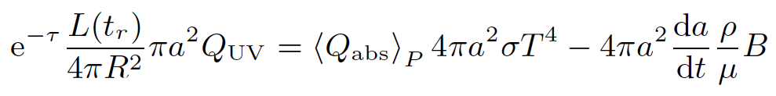

L_{IR} ~ f_{Ω} E_{rad}/(2R_{sub}/c)
~ (1.5x10⁴² erg/s) f_{Ω,-1} E_{rad,51.5} /R_{sub,pc}
Notes:
R_{sub} is the radius out to which dust is sublimated.

Slide 29
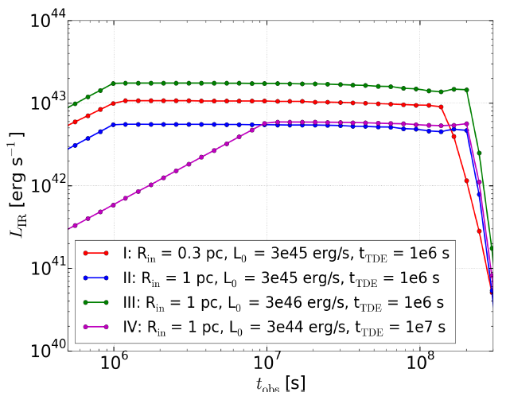
IR Emission from Dust
λ ~ 3 - 10 μm
Notes:
We assume a uniform spatial distribution of dust grains with number density n_{d}, spanning from inner radius R_{in} to outer radius R_{out}; R_{out} is taken to be R_{in} + 1 pc.

Slide 30
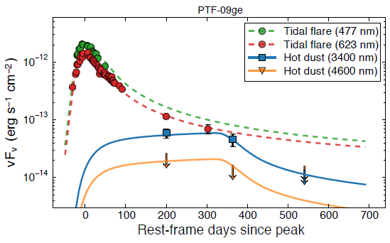

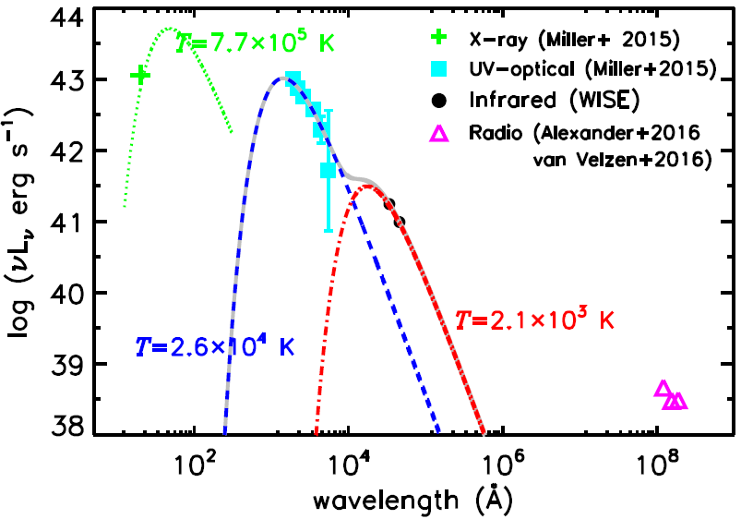
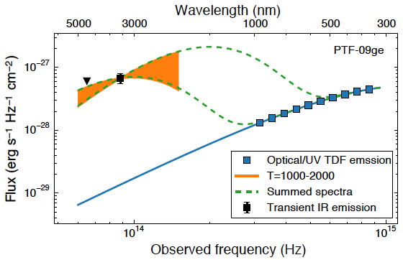
Observations
Wide-field Infrared Survey Explorer (WISE);
van Velzen et al. (2016)
PTF-09ge
– Lu & Kumar (2016)
ASASSN-14li – 36 d after trigger, Jiang+16
L_{IR} ~ (1.5x10⁴² erg/s) f_{Ω,-1} E_{rad,51.5} /R_{sub,pc}
R_{sub} ~ 0.1 pc; E_{rad} ~ 10⁵² erg; f_{Ω} ~ 1%
Notes:
From van Velzen (Fig. 5 caption): Difference flux light curves of optical and IR emission TDFs. The circles show the optical observations of the flare; the dashed line that runs through these points is the light curve of the well-sampled tidal flare PS1-10jh. The baseline-subtracted IR data from WISE is shown by the square symbols; 1σ upper limits are indicated by arrows. Our best-fit model for the IR emission, obtained by reprocessing the tidal flare light in a shell of hot dust (T = 1850 K), is shown by the solid lines.
From Jiang et al. (2016) FIG. 3.— The broadband SED of ASASSN-14li at E1 (MJD≈57019) (see Figure 1). The X-ray, UV and optical data is adapted from Fig. 1 of Miller et al. (2015), the radio data is drawn from Table S1 of van Velzen et al. (2016) and Table 1 of Alexander et al. (2016). The infrared data is coverted from our measurement. The blue dashed line and red dot-dashed line is the two-blackbody fitting to the UV-optical-infrared data, which have been already subtracted the host emission before the TDE.

Slide 31
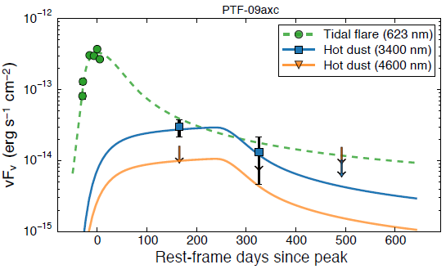
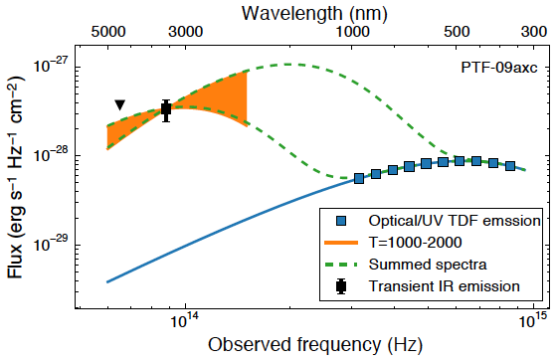
PTF-09axc
Observation of IR emission by dust which was predicted by Lu and Kumar (2016)
Wide-field Infrared Survey Explorer (WISE);
van Velzen et al. (2016)

Slide 32
Summary
✫
Our analysis of the IR to γ-ray data for a jetted TDE – Swift J1644+58 – shows that most of the jet energy was likely in magnetic fields.
✫
Dissipation of the magnetic energy accelerated electrons and produced X-rays via the synchrotron process.
✫
Circum-nuclear dust heated by TDEs produces bright IR radiation, 10⁴¹ – 10⁴³ erg/s, that lasts for 1 – 10 yrs; it is useful for investigating dust within ~1 pc of galactic nuclei.
Notes:
32

