Slide 1
The role of electromagnetism in tidal disruption events
Andrej Čadež
University in Ljubljana

Slide 2
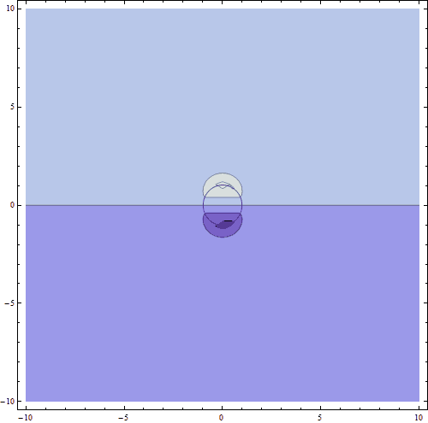
Why should global electomagnetic fields be important in large scale phenomena?
Freefall of pressureless fluid into a black hole.
Question: How can the tidal energy be “almost instantaneously” transformed into X rays?
An out of a sleeve proposal? Gravity directly couples to electromagnetism through dynamics.

Slide 3
Pulsar slow down as an example of coupling dynamics to electromagnetism --- the case of Crab
It is often assumed that pulsars slow down as the result of electromagnetic radiation that they emit as rotating magnets and that their plerionic nebulae are illuminated by synchrotron radiation emitted in the hot corona of the neutron star.
However, detailed observations of the famous Crab nebula and its pulsar present some striking displays which, I believe, point to organized structures on a large scale and thus hint on the presence of the direct coupling of dynamics to electromagnetism.

Slide 4
3D Structure of Crab nebula (by spectroscopy)
Filaments, formed by line radiation from H, N and S (H-red, N-green, S-blue) form a regular cage spread over an almost spherical oval with a parsec across. The gravitational field alone can not form such a structure

Slide 5
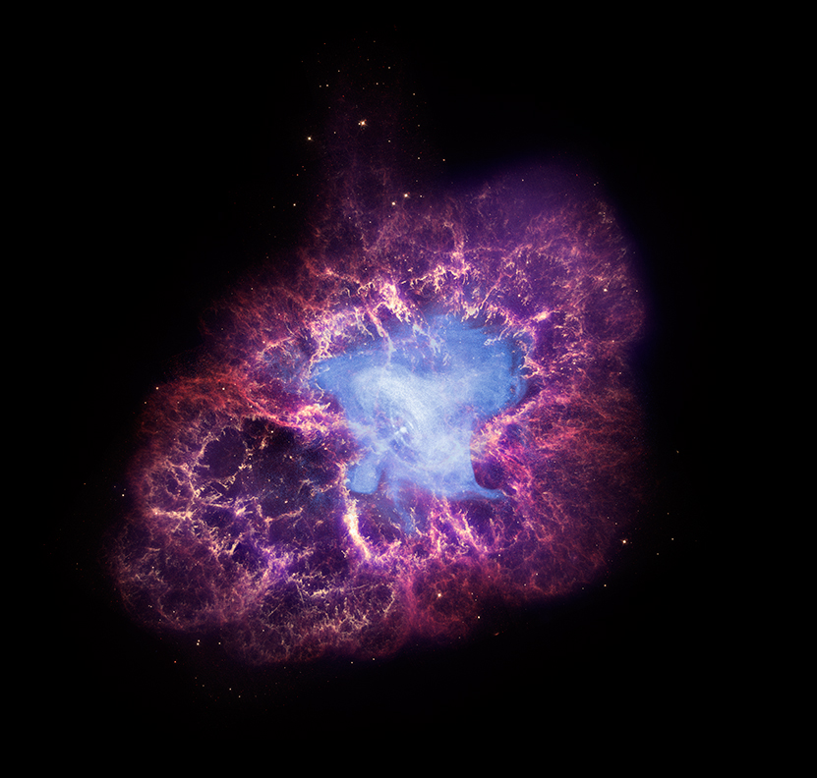
X-rays are emitted in a regular disk-jet pattern, completely contained within the line radiation cage

Slide 6
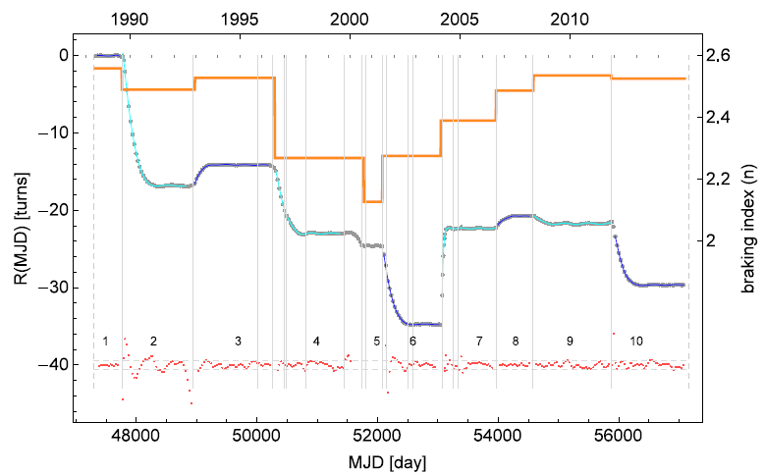
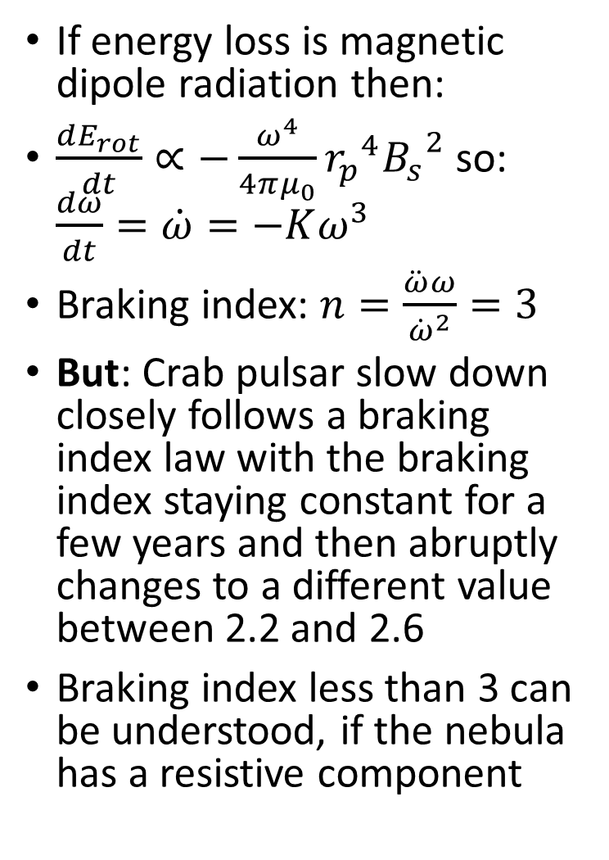
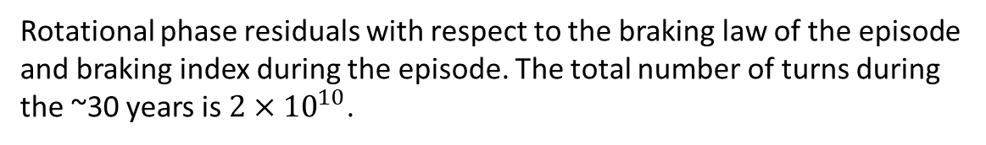
Pulsar slow-down
If energy loss is magnetic dipole radiation then:
$\frac{dE_{rot}}{dt}∝−\frac{ω^{4}}{4πμ_{0}}{r_{p}}^{4}{B_{s}}^{2}$ so: $\frac{dω}{dt}=\dot{ω}=−Kω^{3}$
Braking index: $n=\frac{\ddot{ω}ω}{{\dot{ω}}^{2}}=3$
But: Crab pulsar slow down closely follows a braking index law with the braking index staying constant for a few years and then abruptly changes to a different value between 2.2 and 2.6
Braking index less than 3 can be understood, if the nebula has a resistive component
Rotational phase residuals with respect to the braking law of the episode and braking index during the episode. The total number of turns during the ~30 years is $2×{10}^{10}$.

Slide 7
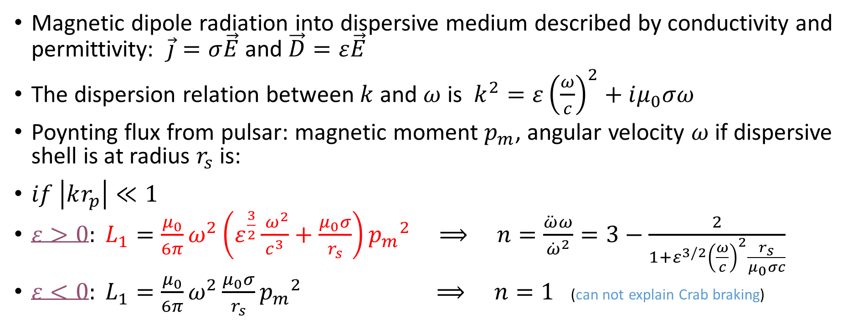
Pulsar EM field interacting with nebula
Magnetic dipole radiation into dispersive medium described by conductivity and permittivity: $\vec{j}=σ\vec{E}$and $\vec{D}=ε\vec{E}$
The dispersion relation between $k$ and $ω$ is $k^{2}=ε{\left(\frac{ω}{c}\right)}^{2}+iμ_{0}σω$
Poynting flux from pulsar: magnetic moment $p_{m}$, angular velocity $ω$if dispersive shell is at radius $r_{s}$ is:
$if \left|kr_{p}\right|≪1$
$ε>0: L_{1}=\frac{μ_{0}}{6π}ω^{2}\left(ε^{\frac{3}{2}}\frac{{ ω}^{2}}{c^{3}}+\frac{μ_{0}σ}{r_{s}}\right){p_{m}}^{2}$ $⟹ n=\frac{\ddot{ω}ω}{{\dot{ω}}^{2}}=3−\frac{2}{1+{ε^{3/2}\left(\frac{ω}{c}\right)}^{2}\frac{r_{s}}{μ_{0}σc}}$
$ε<0: L_{1}=\frac{μ_{0}}{6π}ω^{2}\frac{μ_{0}σ}{r_{s}}{p_{m}}^{2}$ $⟹ n=1$ (can not explain Crab braking)

Slide 8
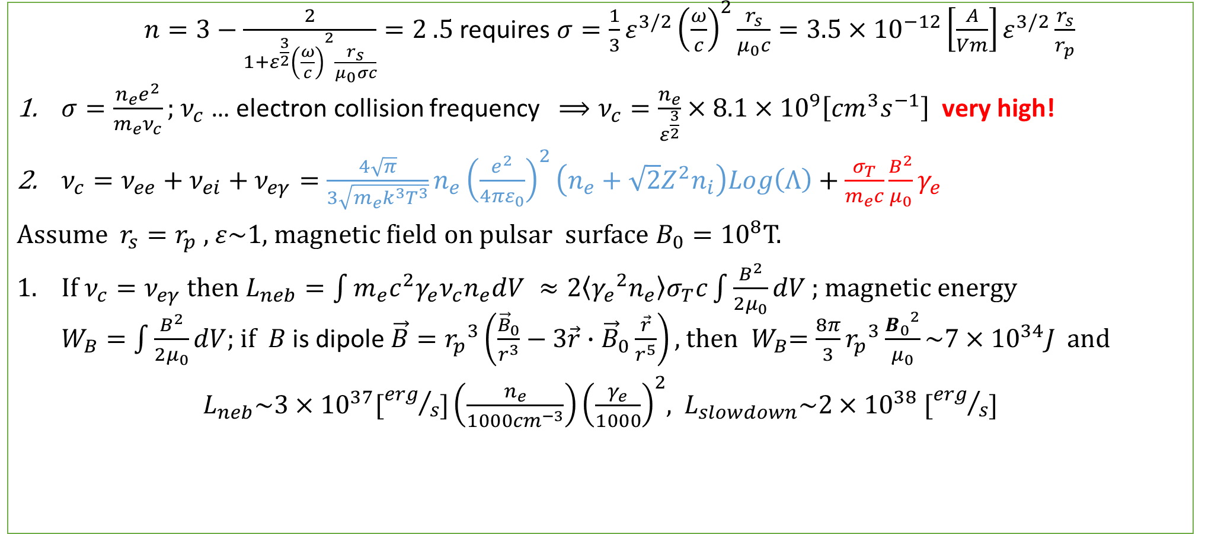
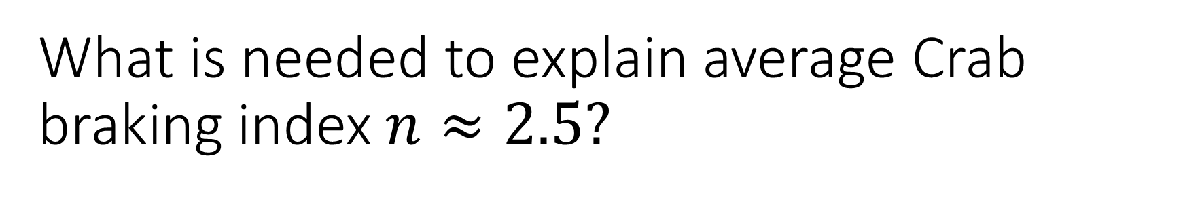
What is needed to explain average Crab braking index $n≈2.5?$
$n=3−\frac{2}{1+{ε^{\frac{3}{2}}\left(\frac{ω}{c}\right)}^{2}\frac{r_{s}}{μ_{0}σc}}=2 .5$ requires $σ=\frac{1}{3}ε^{3/2}{\left(\frac{ω}{c}\right)}^{2}\frac{r_{s}}{μ_{0}c}=3.5×{10}^{−12}\left[\frac{A}{Vm}\right]ε^{3/2}\frac{r_{s}}{r_{p}}$
$σ=\frac{n_{e}e^{2}}{m_{e}ν_{c}};$ $ν_{c}$ … electron collision frequency $⟹ν_{c}=\frac{n_{e}}{ε^{\frac{3}{2}}}×8.1×{10}^{9}\left[{cm}^{3}s^{−1}\right]$ very high!
$ν_{c}=ν_{ee}+ν_{ei}+ν_{eγ}=\frac{4\sqrt{π}}{3\sqrt{m_{e}k^{3}T^{3}}}n_{e}{\left(\frac{e^{2}}{4πε_{0}}\right)}^{2}\left(n_{e}+\sqrt{2}Z^{2}n_{i}\right)Log\left(Λ\right)+\frac{σ_{T}}{m_{e}c}\frac{B^{2}}{μ_{0}}γ_{e}$
Assume $r_{s}=r_{p} ,$ $ε\sim 1,$ magnetic field on pulsar surface $B_{0}={10}^{8}$T.
If $ν_{c}=ν_{eγ}$ then $L_{neb}=\int{m_{e}c^{2}γ_{e}ν_{c}n_{e}dV ≈2\left\langle {γ_{e}}^{2}n_{e}\right\rangle σ_{T}c\int{\frac{B^{2}}{{2μ}_{0}}dV} }$; magnetic energy $W_{B}=\int{\frac{B^{2}}{{2μ}_{0}}dV}$; if $B$ is dipole $\vec{B}={r_{p}}^{3}\left(\frac{{\vec{B}}_{0}}{r^{3}}−3\vec{r}∙{\vec{B}}_{0}\frac{\vec{r}}{r^{5}}\right),$ then ${ W}_{B}=\frac{8π}{3}{r_{p}}^{3}\frac{{B_{0}}^{2}}{μ_{0}}\sim 7×{10}^{34}J$ and
$L_{neb}\sim 3×{10}^{37}[{erg}/s]\left(\frac{n_{e}}{1000{cm}^{−3}}\right){\left(\frac{γ_{e}}{1000}\right)}^{2}$, $L_{slowdown}\sim 2×{10}^{38}$ $[{erg}/s]$

Slide 9
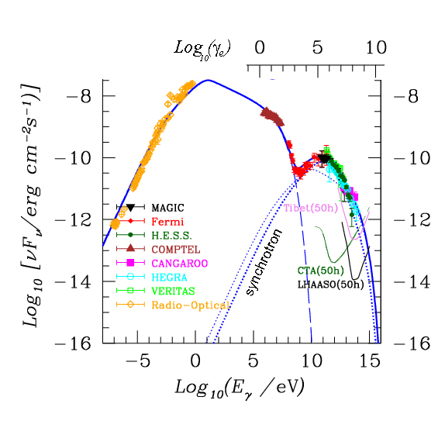
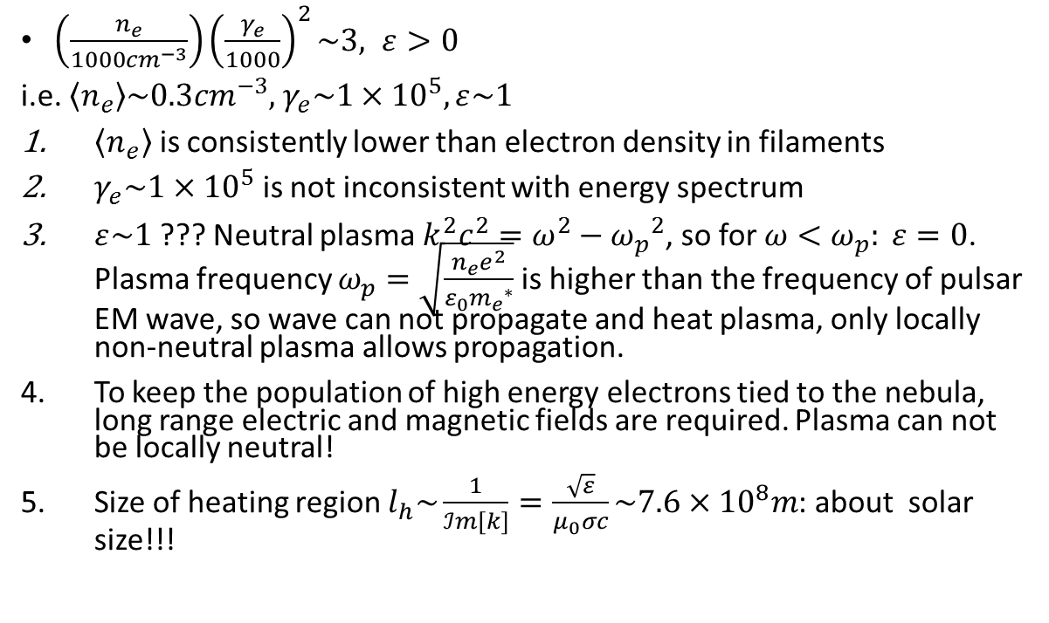
Can the nebular plasma satisfy the calculated conditions?
$\left(\frac{n_{e}}{1000{cm}^{−3}}\right){\left(\frac{γ_{e}}{1000}\right)}^{2}\sim 3, ε>0$
i.e. $\left\langle n_{e}\right\rangle \sim 0.3{cm}^{−3},$ $γ_{e}\sim 1×{10}^{5}, ε\sim 1$
$\left\langle n_{e}\right\rangle$ is consistently lower than electron density in filaments
$γ_{e}\sim 1×{10}^{5}$ is not inconsistent with energy spectrum
$ε\sim 1$ ??? Neutral plasma $k^{2}c^{2}=ω^{2}−{ω_{p}}^{2}$, so for $ω<ω_{p}: ε=0$. Plasma frequency $ω_{p}=\sqrt{\frac{n_{e}e^{2}}{ε_{0}{m_{e}}^{∗}}}$is higher than the frequency of pulsar EM wave, so wave can not propagate and heat plasma, only locally non-neutral plasma allows propagation.
To keep the population of high energy electrons tied to the nebula, long range electric and magnetic fields are required. Plasma can not be locally neutral!
Size of heating region $l_{h}\sim \frac{1}{ℐm[k]}=\frac{\sqrt{ε}}{μ_{0}σc}\sim 7.6×{10}^{8}m$: about solar size!!!
Kohri, Ohira, Ioka: MNRAS2012

Slide 10
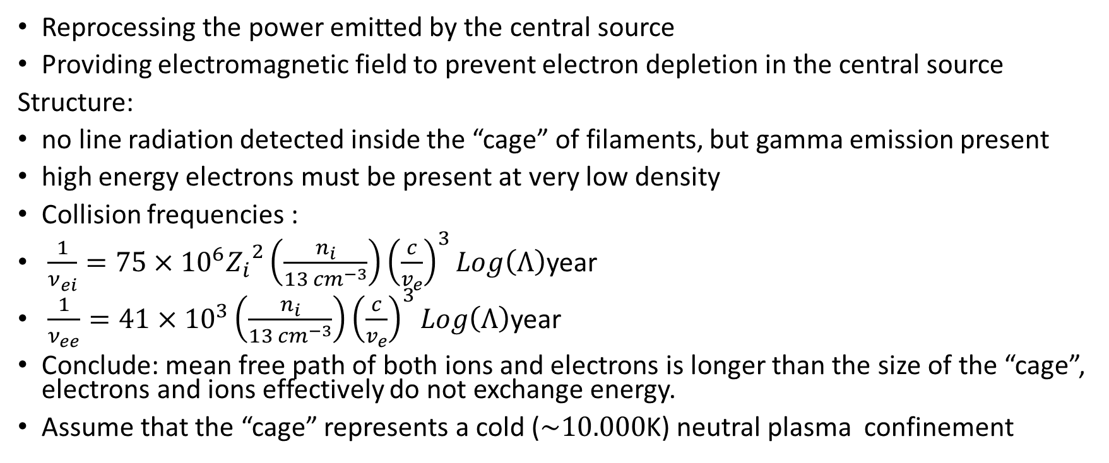
The role of the nebula and assumed structure
Reprocessing the power emitted by the central source
Providing electromagnetic field to prevent electron depletion in the central source
Structure:
no line radiation detected inside the “cage” of filaments, but gamma emission present
high energy electrons must be present at very low density
Collision frequencies :
$\frac{1}{ν_{ei}}=75×{10}^{6}{Z_{i}}^{2}\left(\frac{n_{i}}{13 {cm}^{−3}}\right){\left(\frac{c}{v_{e}}\right)}^{3}Log\left(Λ\right)$year
$\frac{1}{ν_{ee}}=41×{10}^{3}\left(\frac{n_{i}}{13 {cm}^{−3}}\right){\left(\frac{c}{v_{e}}\right)}^{3}Log\left(Λ\right)$year
Conclude: mean free path of both ions and electrons is longer than the size of the “cage”, electrons and ions effectively do not exchange energy.
Assume that the “cage” represents a cold ($\sim 10.000$K) neutral plasma confinement

Slide 11
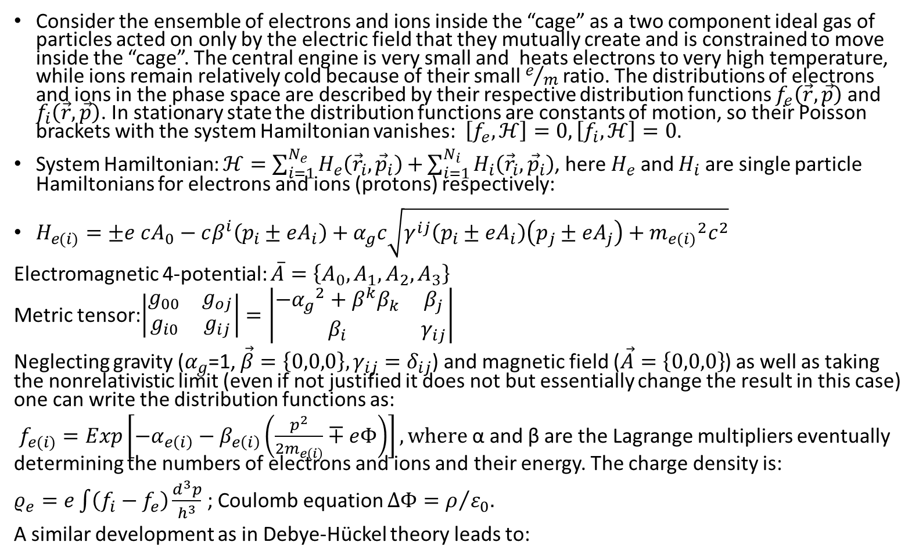
Boltzmann and generation of electric field
Consider the ensemble of electrons and ions inside the “cage” as a two component ideal gas of particles acted on only by the electric field that they mutually create and is constrained to move inside the “cage”. The central engine is very small and heats electrons to very high temperature, while ions remain relatively cold because of their small $e/m$ ratio. The distributions of electrons and ions in the phase space are described by their respective distribution functions $f_{e}\left(\vec{r},\vec{p}\right)$and $f_{i}\left(\vec{r},\vec{p}\right)$. In stationary state the distribution functions are constants of motion, so their Poisson brackets with the system Hamiltonian vanishes: $\left[f_{e},ℋ\right]=0,\left[f_{i},ℋ\right]=0$.
System Hamiltonian: $ℋ=\sum_{i=1}^{N_{e}}{H_{e}\left({\vec{r}}_{i},{\vec{p}}_{i}\right)+}\sum_{i=1}^{N_{i}}{H_{i}\left({\vec{r}}_{i},{\vec{p}}_{i}\right)}$, here $H_{e}$ and $H_{i}$ are single particle Hamiltonians for electrons and ions (protons) respectively:
$H_{e(i)}=±e cA_{0}−cβ^{i}\left(p_{i}±eA_{i}\right)+α_{g}c\sqrt{γ^{ij}\left(p_{i}±eA_{i}\right)\left(p_{j}±eA_{j}\right)+{m_{e(i)}}^{2}c^{2}}$
Electromagnetic 4-potential: $\overline{A}=\left\{A_{0},A_{1},A_{2},A_{3}\right\}$
Metric tensor:$\left|\begin{matrix}g_{00} & g_{oj} \\ g_{i0} & g_{ij}\end{matrix}\right|=\left|\begin{matrix}−{α_{g}}^{2}+β^{k}β_{k} & β_{j} \\ β_{i} & γ_{ij}\end{matrix}\right|$
Neglecting gravity ($α_{g}$=1, $\vec{β}=\left\{0,0,0\right\}, γ_{ij}=δ_{ij}$) and magnetic field ($\vec{A}=\left\{0,0,0\right\}$) as well as taking the nonrelativistic limit (even if not justified it does not but essentially change the result in this case) one can write the distribution functions as:
$f_{e(i)}=Exp\left[−α_{e\left(i\right)}−β_{e\left(i\right)}\left(\frac{p^{2}}{2m_{e\left(i\right)}}∓eΦ\right)\right], where$α and β are the Lagrange multipliers eventually determining the numbers of electrons and ions and their energy. The charge density is:
$ρ_{e}=e\int{\left(f_{i}−f_{e}\right)\frac{d^{3}p}{h^{3}}}$ ; Coulomb equation $ΔΦ=ρ/{ε_{0}.}$
A similar development as in Debye-Hückel theory leads to:

Slide 12
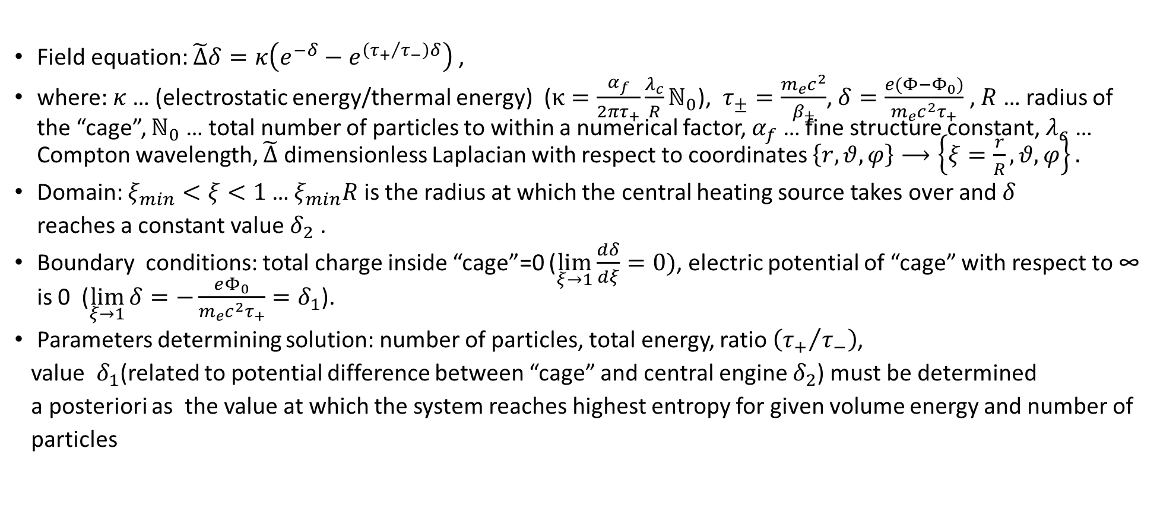
Electric field in rarefied plasma of electrons and ions of different temperature
Field equation: $\tilde{Δ}δ=κ\left(e^{−δ}−e^{\left({τ_{+}}/{τ_{−}}\right)δ}\right)$ ,
where: $κ$… (electrostatic energy/thermal energy) ($κ=\frac{α_{f}}{2πτ_{+}}\frac{λ_{c}}{R}ℕ_{0}$), $τ_{±}=\frac{m_{e}c^{2}}{β_{±}}$, $δ=\frac{e(Φ−Φ_{0})}{m_{e}c^{2}τ_{+}}$ , $R$ … radius of the “cage”, $ℕ_{0}$ … total number of particles to within a numerical factor, $α_{f}$ … fine structure constant, $λ_{c}$ … Compton wavelength, $\tilde{Δ}$ dimensionless Laplacian with respect to coordinates $\left\{r,θ,φ\right\}⟶\left\{ξ=\frac{r}{R},θ,φ\right\}.$
Domain: $ξ_{min}<ξ<1$ … $ξ_{min}R$ is the radius at which the central heating source takes over and $δ$
reaches a constant value $δ_{2}$ .
Boundary conditions: total charge inside “cage”=0 ($\lim_{ξ→1}{\frac{dδ}{dξ}=0})$, electric potential of “cage” with respect to ∞ is 0 ($\lim_{ξ→1}{δ=−\frac{eΦ_{0}}{m_{e}c^{2}τ_{+}}=δ_{1}}$).
Parameters determining solution: number of particles, total energy, ratio $\left({τ_{+}}/{τ_{−}}\right)$,
value $δ_{1}$(related to potential difference between “cage” and central engine $δ_{2}$) must be determined
a posteriori as the value at which the system reaches highest entropy for given volume energy and number of
particles

Slide 13
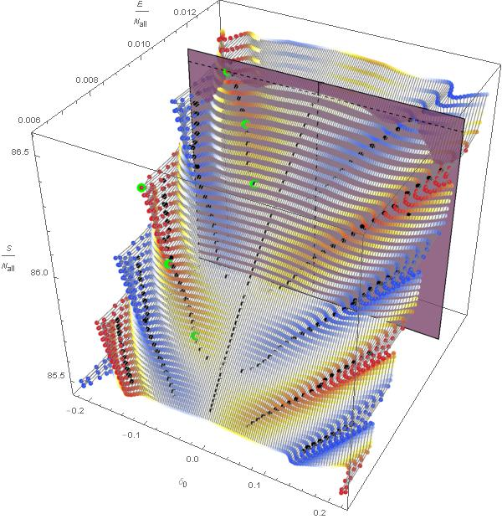

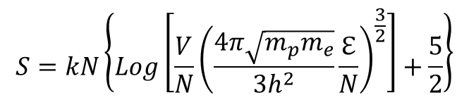
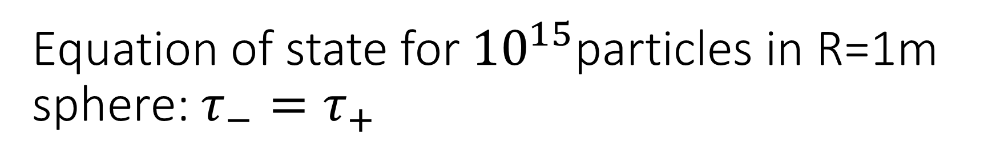
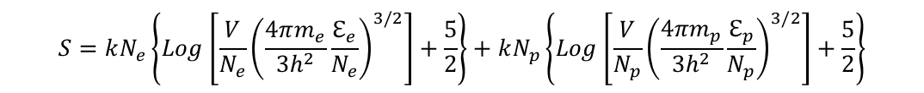
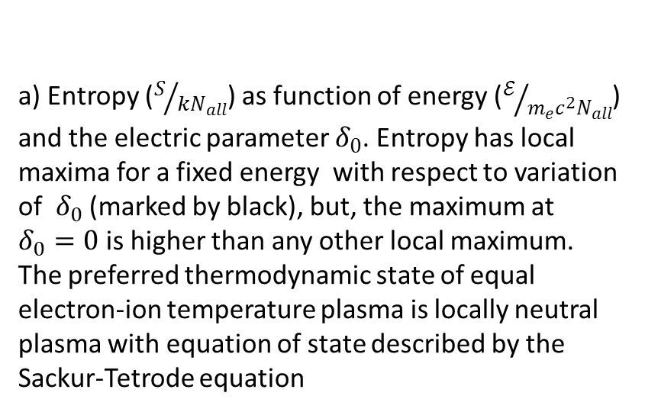
Equation of state for ${10}^{15}$particles in R=1m sphere: $τ_{−}=τ_{+}$
a) Entropy ($S/{kN_{all}}$) as function of energy ($ℰ/{m_{e}c^{2}N_{all}}$) and the electric parameter $δ_{0}$. Entropy has local maxima for a fixed energy with respect to variation of $δ_{0}$ (marked by black), but, the maximum at $δ_{0}=0$is higher than any other local maximum. The preferred thermodynamic state of equal electron-ion temperature plasma is locally neutral plasma with equation of state described by the Sackur-Tetrode equation
$$S=kN_{e}\left\{Log\left[\frac{V}{N_{e}}{\left(\frac{4πm_{e}}{3h^{2}}\frac{ℇ_{e}}{N_{e}}\right)}^{3/2}\right]+\frac{5}{2}\right\}+kN_{p}\left\{Log\left[\frac{V}{N_{p}}{\left(\frac{4πm_{p}}{3h^{2}}\frac{ℇ_{p}}{N_{p}}\right)}^{3/2}\right]+\frac{5}{2}\right\}$$
$$S=kN\left\{Log\left[\frac{V}{N}{\left(\frac{4π\sqrt{m_{p}m_{e}}}{3h^{2}}\frac{ℇ}{N}\right)}^{\frac{3}{2}}\right]+\frac{5}{2}\right\}$$

Slide 14
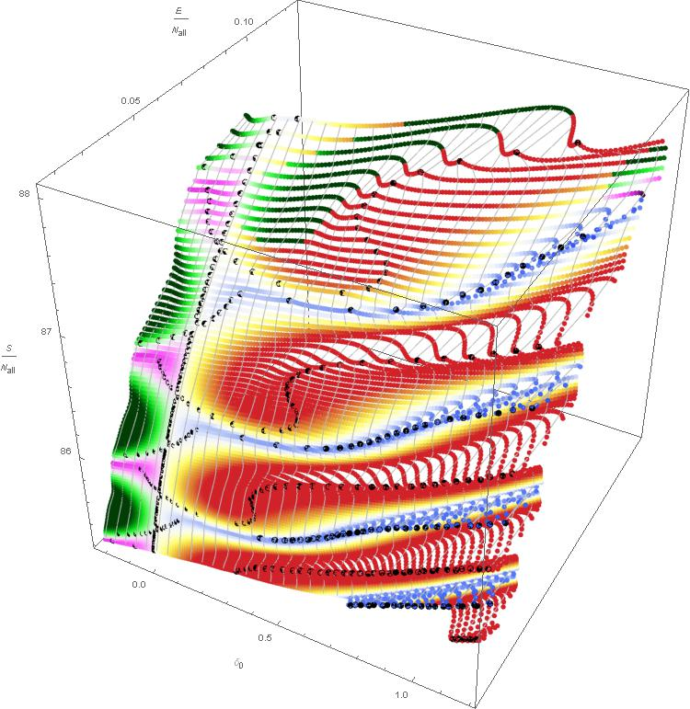

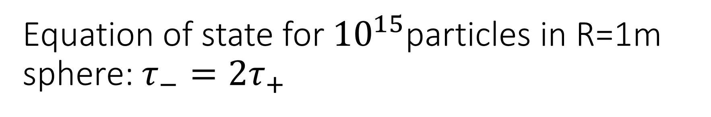
Equation of state for ${10}^{15}$particles in R=1m sphere: $τ_{−}=2τ_{+}$
States colored with colors of the bottom code all have higher entropy than that of the electrically neutral state at the same energy , many local entropy maxima generate states that are more probable than the state of local charge neutrality.

Slide 15
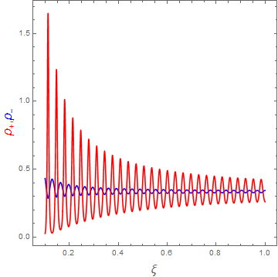
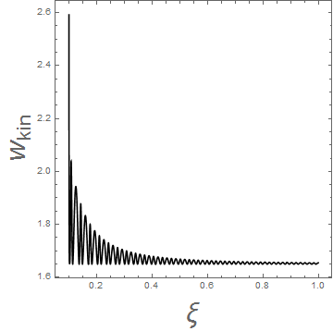
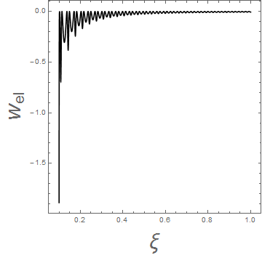

Properties of non-neutral states
Charge density as a function of radius (for spherically symmetric boundary conditions!)
The higher temperature component yields some entropy to allow the low temperature component to occupy more phase space, which makes the entropy of the complete system to increase (A process similar to crystallization?).
The deep electrostatic well allows electrons in the central source to have very high kinetic energy, even if the pressure at $ξ=1$ is very low.

Slide 16
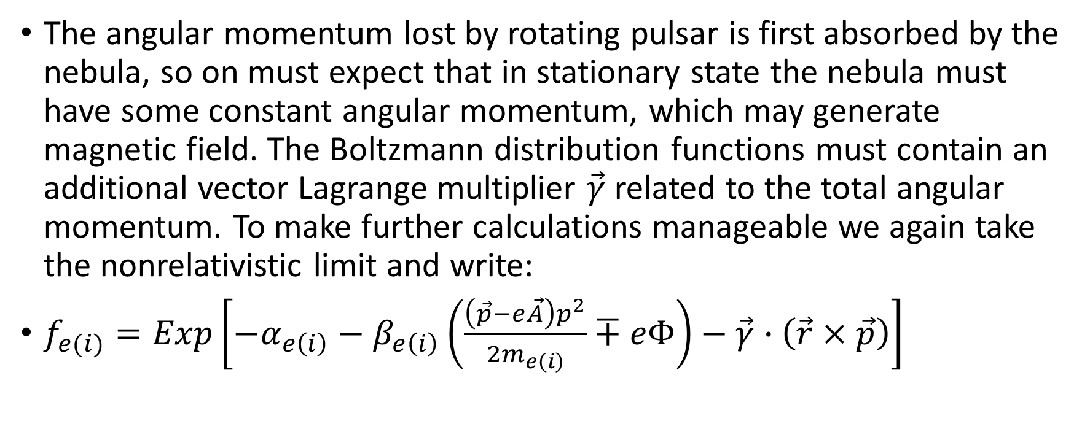
Boltzmann and generation of magnetic field
The angular momentum lost by rotating pulsar is first absorbed by the nebula, so on must expect that in stationary state the nebula must have some constant angular momentum, which may generate magnetic field. The Boltzmann distribution functions must contain an additional vector Lagrange multiplier $\vec{γ}$ related to the total angular momentum. To make further calculations manageable we again take the nonrelativistic limit and write:
$f_{e(i)}=Exp\left[−α_{e\left(i\right)}−β_{e\left(i\right)}\left(\frac{{\left(\vec{p}−e\vec{A}\right)p}^{2}}{2m_{e\left(i\right)}}∓eΦ\right)−\vec{γ}∙\left(\vec{r}×\vec{p}\right)\right]$

Slide 17
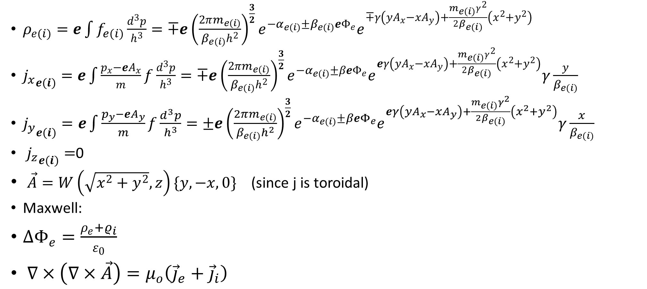
Field equations
$ρ_{e(i)}=e\int{f_{e(i)}}\frac{d^{3}p}{h^{3}}=∓e{\left(\frac{2πm_{e(i)}}{β_{e(i)}h^{2}}\right)}^{\frac{3}{2}}e^{−α_{e(i)}±β_{e(i)}eΦ_{e}}e^{∓γ\left(yA_{x}−xA_{y}\right)+\frac{m_{e(i)}γ^{2}}{2β_{e(i)}}\left(x^{2}+y^{2}\right)}$
${j_{x}}_{e(i)}=e\int{\frac{p_{x}−{eA}_{x}}{m}f}\frac{d^{3}p}{h^{3}}=∓e{\left(\frac{2πm_{e(i)}}{β_{e(i)}h^{2}}\right)}^{\frac{3}{2}}e^{−α_{e(i)}±βeΦ_{e}}e^{eγ\left(yA_{x}−xA_{y}\right)+\frac{m_{e(i)}γ^{2}}{2β_{e(i)}}\left(x^{2}+y^{2}\right)}γ\frac{y}{β_{e(i)}}$
${j_{y}}_{e(i)}=e\int{\frac{p_{y}−{eA}_{y}}{m}f}\frac{d^{3}p}{h^{3}}=±e{\left(\frac{2πm_{e(i)}}{β_{e(i)}h^{2}}\right)}^{\frac{3}{2}}e^{−α_{e(i)}±βeΦ_{e}}e^{eγ\left(yA_{x}−xA_{y}\right)+\frac{m_{e(i)}γ^{2}}{2β_{e(i)}}\left(x^{2}+y^{2}\right)}γ\frac{x}{β_{e(i)}}$
${j_{z}}_{e(i)}=$0
$\vec{A}=W\left(\sqrt{x^{2}+y^{2}},z\right)\{y,−x,0\}$ (since j is toroidal)
Maxwell:
$∆Φ_{e}=\frac{ρ_{e}+ρ_{i}}{ε_{0}}$
$∇×\left(∇×\vec{A}\right)=μ_{o}\left({\vec{j}}_{e}+{\vec{j}}_{i}\right)$

Slide 18
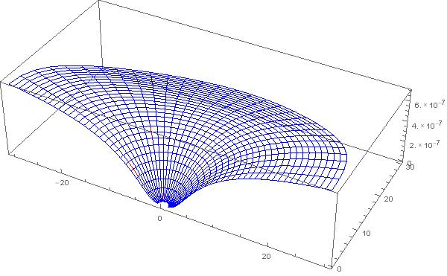
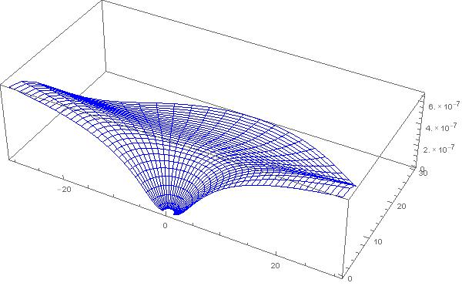
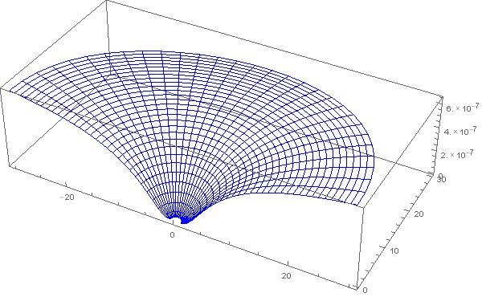
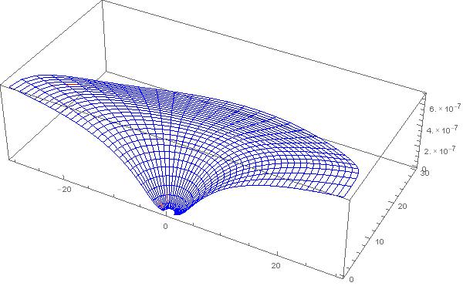
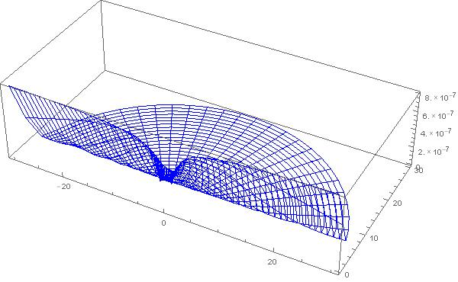
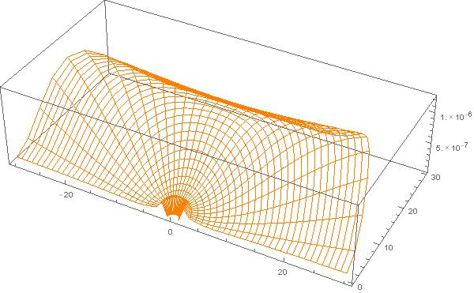
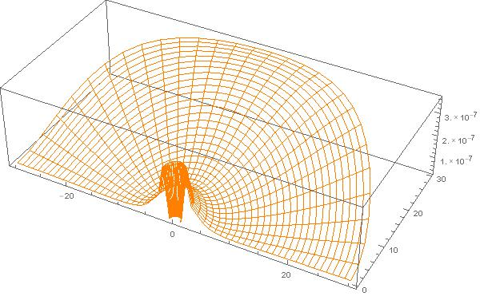
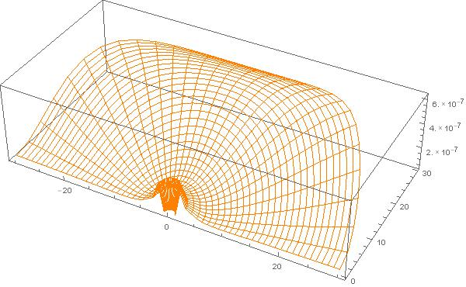
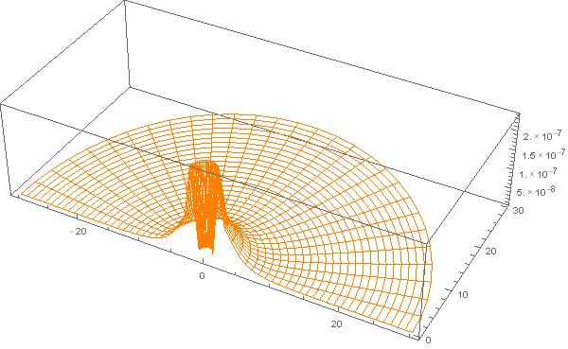
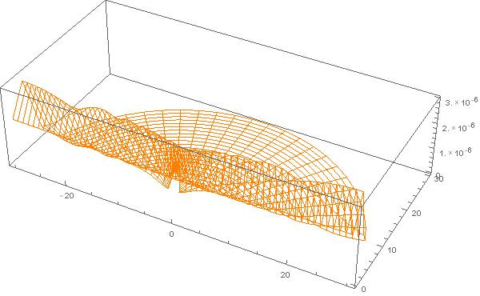


Simplified field equations and solutions
Boundary conditions all positive charge at center, total charge in spherical enclosure zero, enclosure “superconductive”
$∆Φ_{e} = \frac{e}{ε_{0}}{\left(\frac{2πm}{βh^{2}}\right)}^{\frac{3}{2}}e^{−α+βeΦ_{e}}e^{γe\left(W+\frac{mγ}{2eβ}\right)r^{2}{Sin}^{2}θ}+\frac{q}{ε_{0}}δ^{3}\left(\vec{r}\right)$ $Δ =\left(\frac{∂^{2}}{∂r^{2}}+\frac{2}{r}\frac{∂}{∂r}+\frac{1}{r^{2}}\left(\frac{∂^{2}}{∂θ^{2}}+ Cot\left(θ\right)\frac{∂}{∂θ}\right)\right)$
$∆_{W}W=−\frac{ μ_{0}e}{β}{\left(\frac{2πm}{βh^{2}}\right)}^{\frac{3}{2}}e^{−α+βeΦ_{e}}e^{γe\left(W+\frac{mγ}{2eβ}\right)r^{2}{Sin}^{2}θ}γ$ $Δ_{W}=\left(\frac{∂^{2}}{∂r^{2}}+\frac{4}{r}\frac{∂}{∂r}+\frac{1}{r^{2}}\left(\frac{∂^{2}}{∂θ^{2}}+3 Cot\left(θ\right)\frac{∂}{∂θ}\right)\right)$
$$q γ τ$$
60 0.05 0.25
60 0.133 0.25
60 0.195 0.25
60 0.4 2
60 0.1 0.25

Slide 19
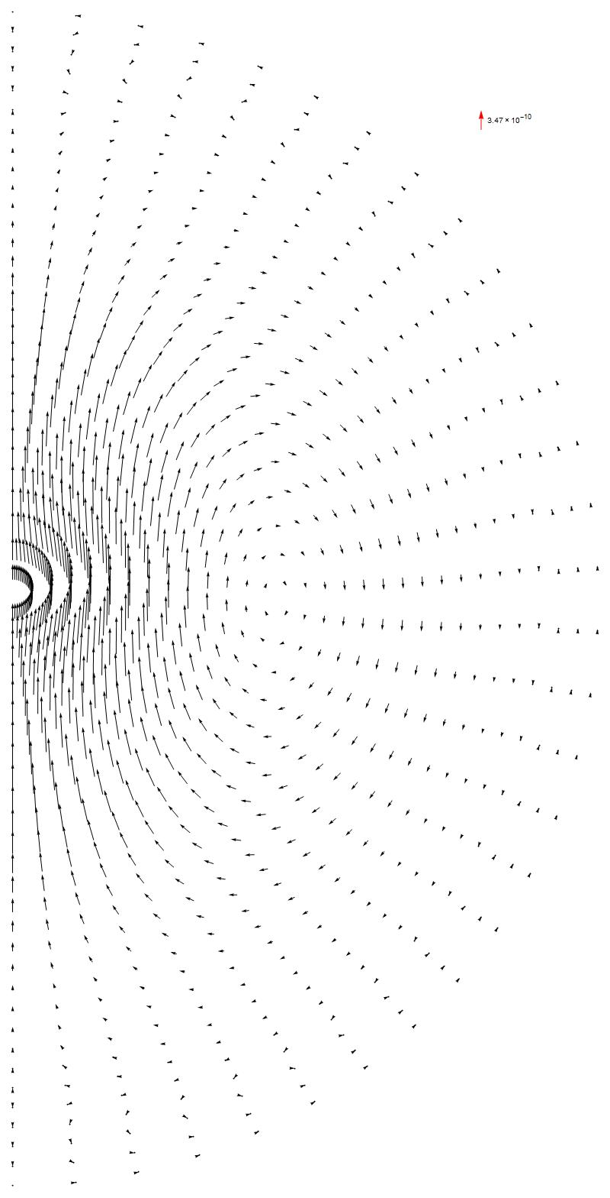
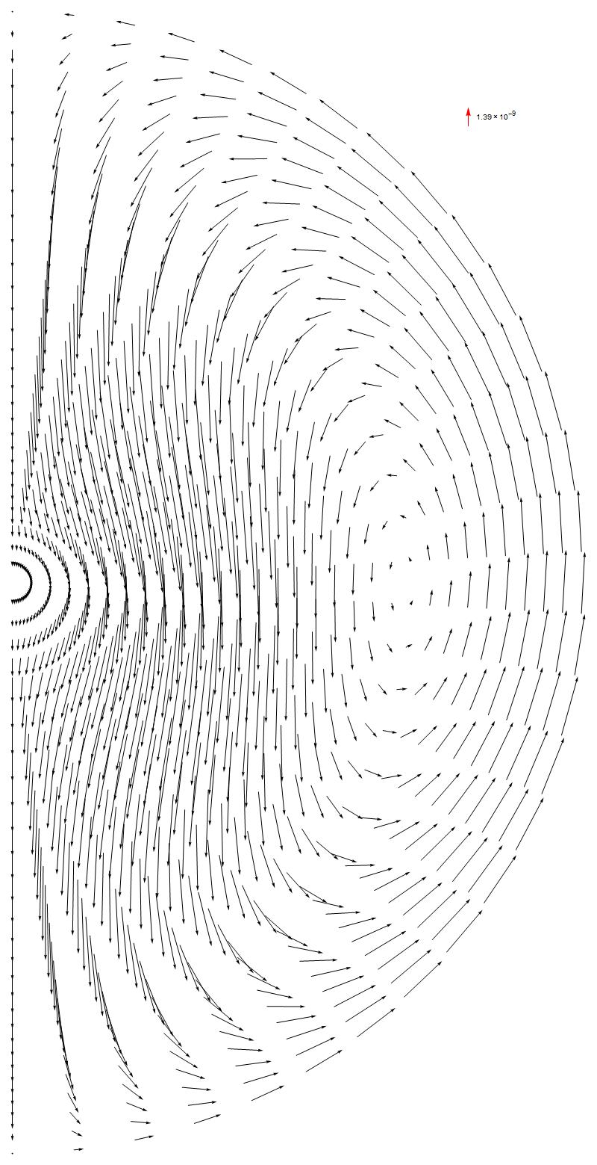

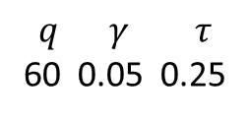
Magnetic field behavior
Increasing angular momentum makes magnetic stress stronger at equator
$$q γ τ$$
60 0.05 0.25
$$q γ τ$$
60 0.1 0.25

Slide 20
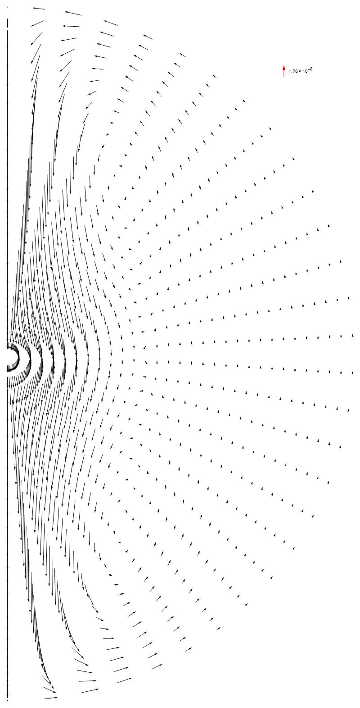
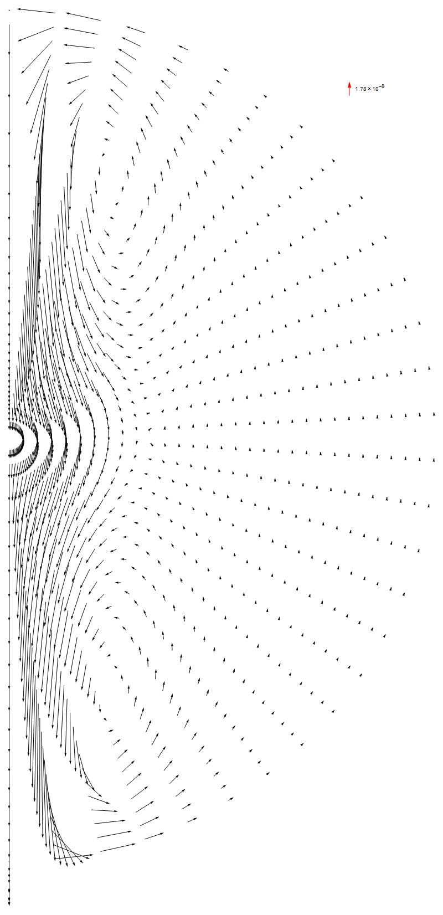
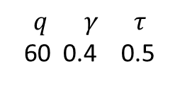
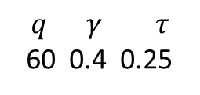
Increasing temperature with high angular momentum increases the pressure of the jet
$$q γ τ$$
60 0.4 0.25
$$q γ τ$$
60 0.4 0.5

Slide 21
Conclusions
The preliminary results suggest that very rarified collision-less plasma segregates into regions with alternating density of electrons and ions
Such plasma can exist in cavities behind shock fronts in interstellar space.
The potential difference between the center of the cavity and its surface grows with disparity between ion and electron temperature and allows electrons at the center to have large kinetic energy.
If angular momentum of the heating source is fed to the plasma, it naturally induces magnetic field and forms jets (and probably synchrotron disk as well)

