Slide 1
THE HIGH-EFFICIENCY JETS MAGNETICALLY ACCELERATED FROM A THIN DISK IN POWERFUL LOBE-DOMINATED FRII RADIO GALAXIES
Li Shuang-Liang
Shanghai Astronomical Observatory, China

Slide 2
Outline
1 MOTIVATION
2 MODEL
3 RESULTS
4 CONCLUSIONS AND DISCUSSION

Slide 3
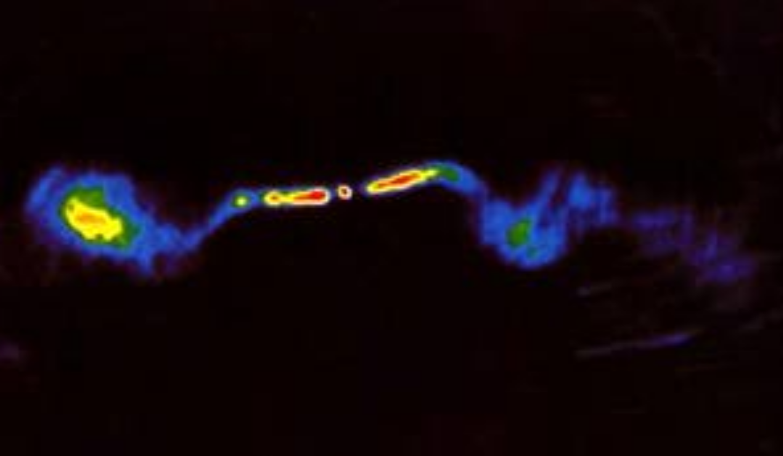
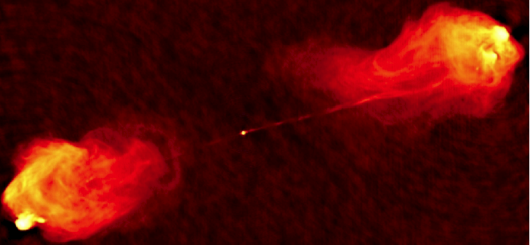
1 MOTIVATION
FRI (3C 449)
FRI: bright jets in the centre and edge-darkened radio lobes.
FRII: edge-brightened radio lobes and hot spots (Fanaroff & Riley 1974).
FRII (Cyg A)

Slide 4
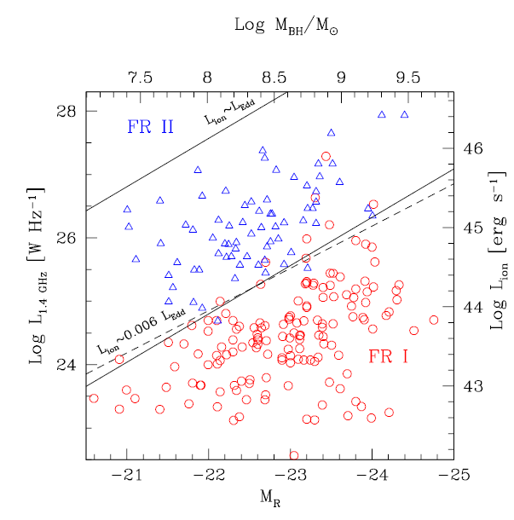
Accretion disk model
Thin disk
Ghisellini &
Celotti (2001)
ADAF

Slide 5
Several observational data discovered the jet efficiency (defined as R = L_{jet}/L_{bol}) of some luminous lobe dominated FRII could be very high.

Slide 6
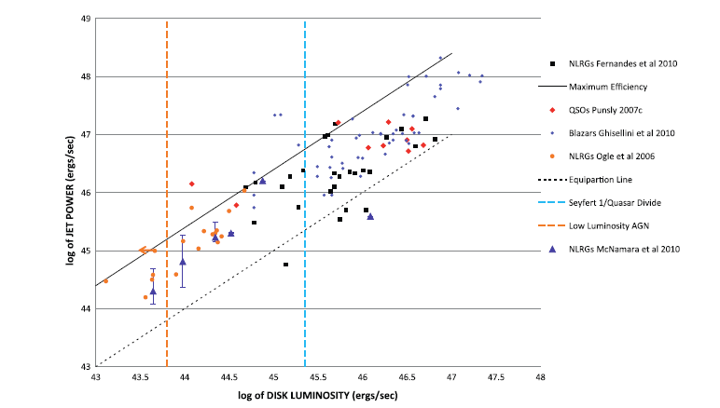
R=L_{jet}/L_{bol}=25
Punsly 2011
1: The low-frequency (151 MHz) flux from the radio (e.g., Willott et al. 1999)
2: The cavities blown up by jets (e.g., Birzan et al. 2004)
3: The broadband spectra associated with the relativistic parsec scale jet (e.g., Ghisellini et al. 2010).

Slide 7
L_{bol} = η_{th} Ṁ c²
R= L_{jet}/L_{bol} = η_{Q} / η_{th}
L_{jet} = η_{Q} Ṁ c²
Where η_{th} is the radiative efficiency and η_{Q} is the jet production efficiency.
For thin disk, η_{th} ~0.1
Simulations found the maximal efficiency η_{Q ~}140% was achieved in the BZ process simulations for a = 0.99. (McKinney 2005; Tchekhovskoy et al. 2010, 2011)
R_{max}~14

Slide 8
Li & Cao (2012) and and Li & Begelman (2014) produced a model for an accretion disk with magnetically driven outflows/jets, in which the effects of jets are properly included.
It was found that the disk properties can be significantly changed by the feedback of jets. The temperature of an thin disk with jets is obvious lower compared with that of a standard thin disk. This will directly result in the decrease of bolometric luminosity (and η_{th}) of the thin disk and the increase of jet efficiency R.

Slide 9
2 Model The equations of accretion disk
The metric around the black hole reads (the geometrical unit G = c = 1 is adopted):

Slide 10
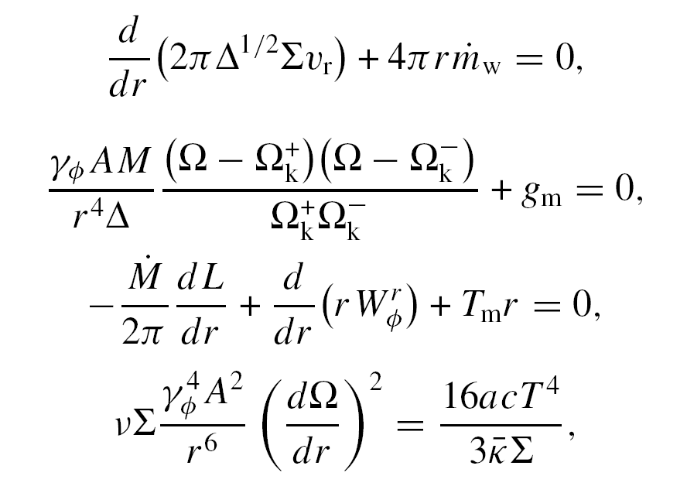

Slide 11
The mechanisms of jet formation
BZ process
BP process

Slide 12
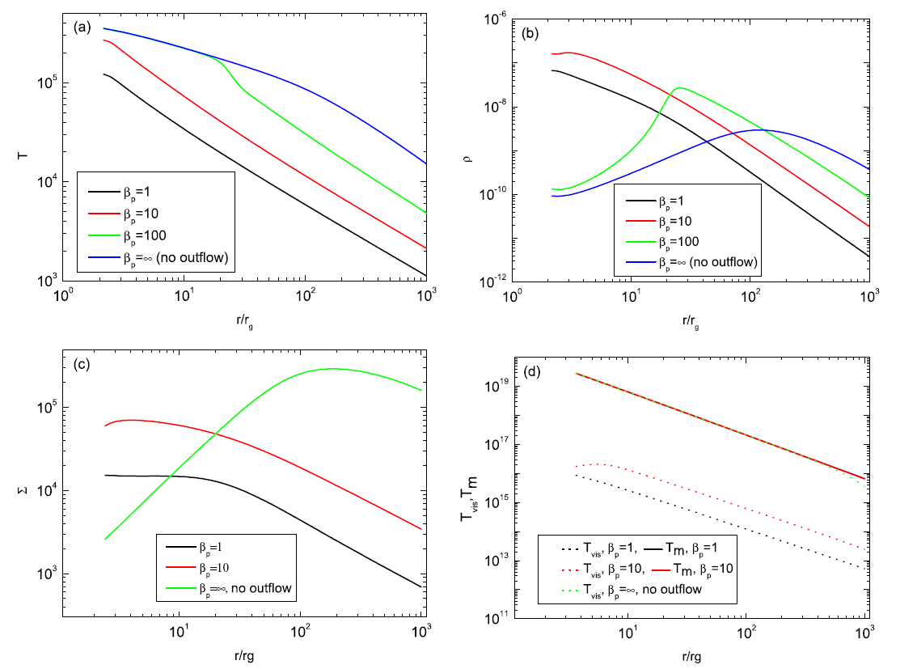
3 Results
β _{p}=(P_{gas}+P_{rad})/P_{m}

Slide 13
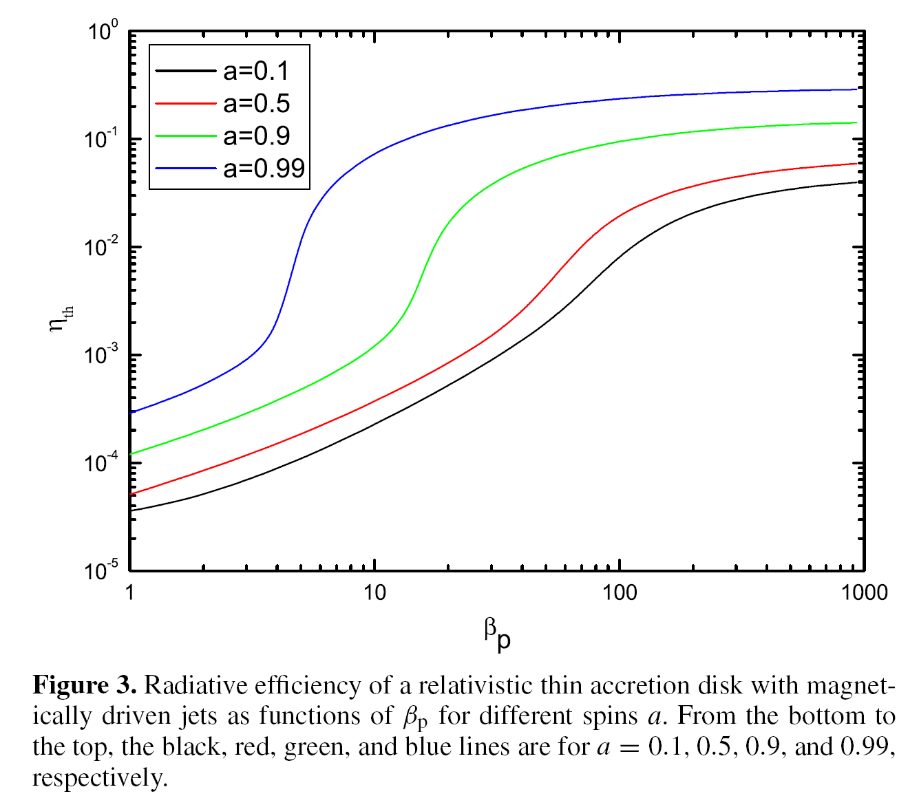
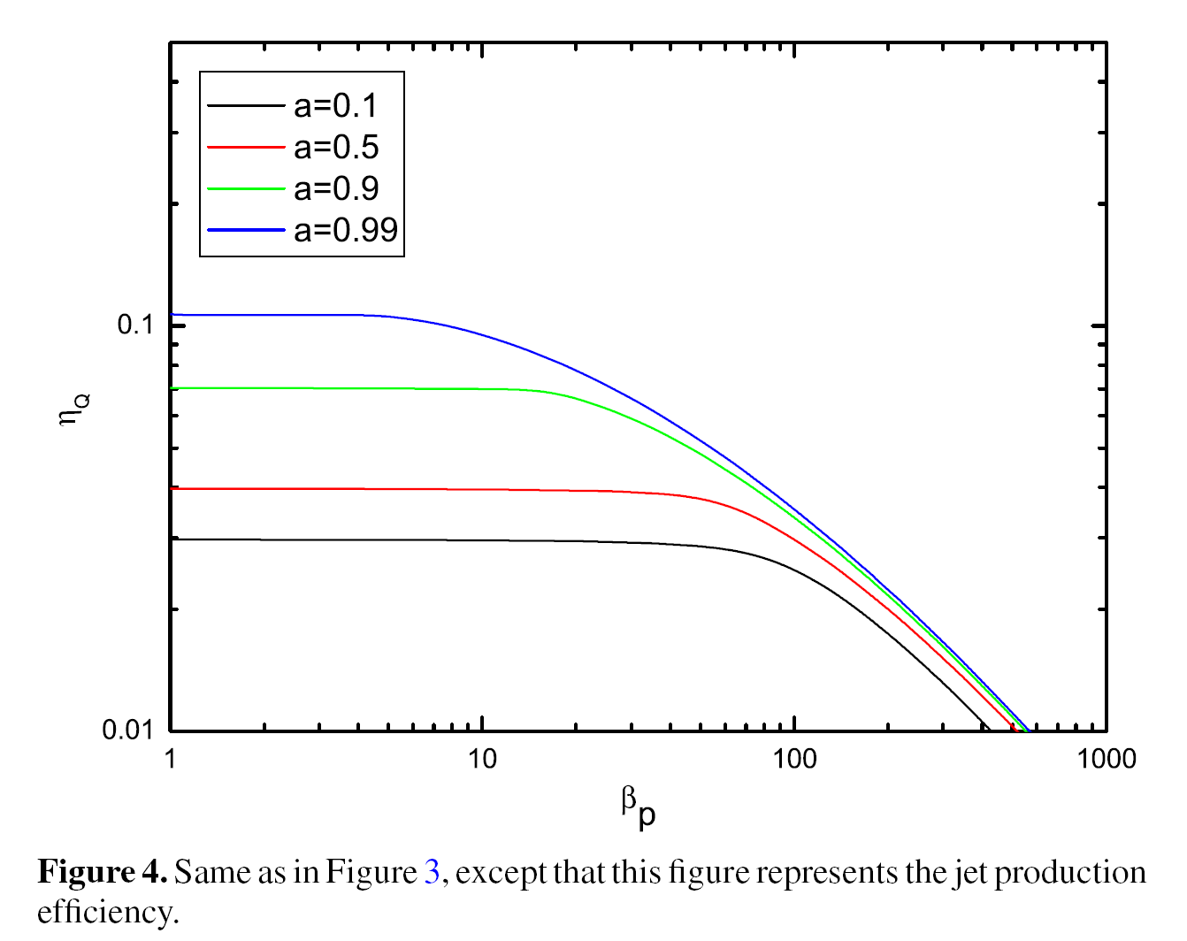
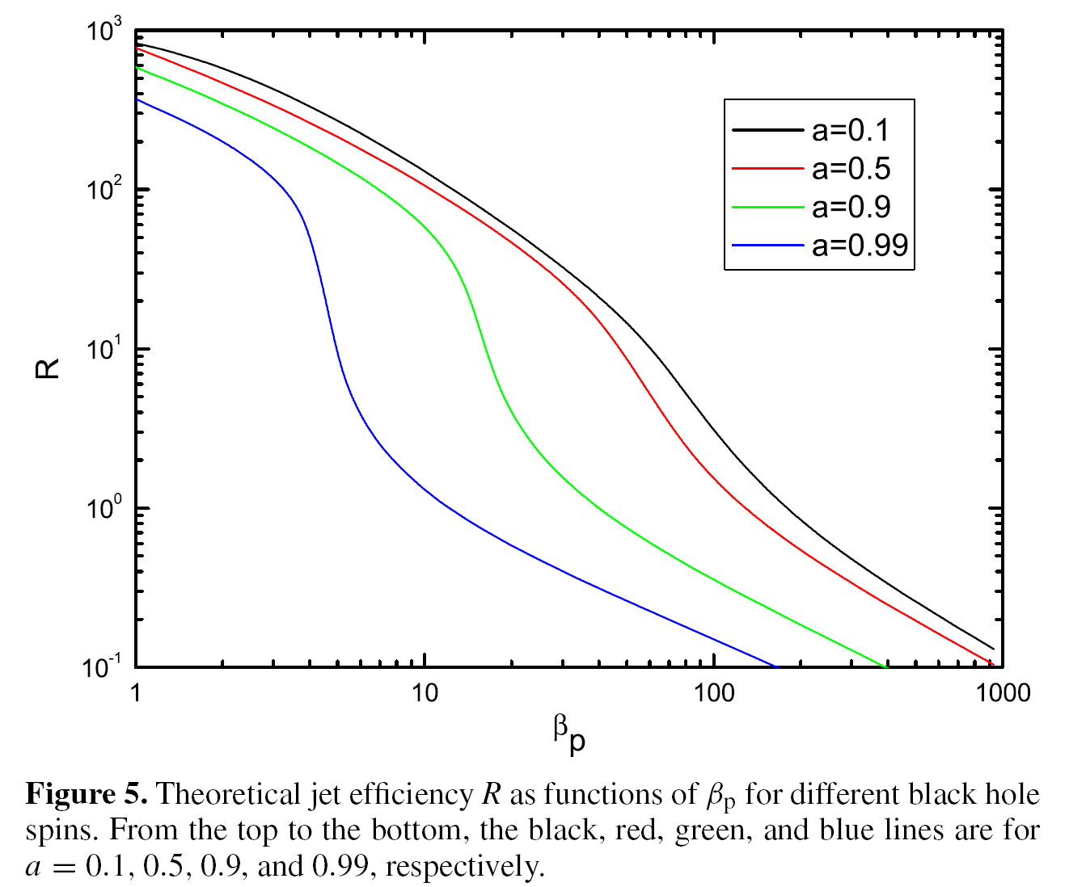
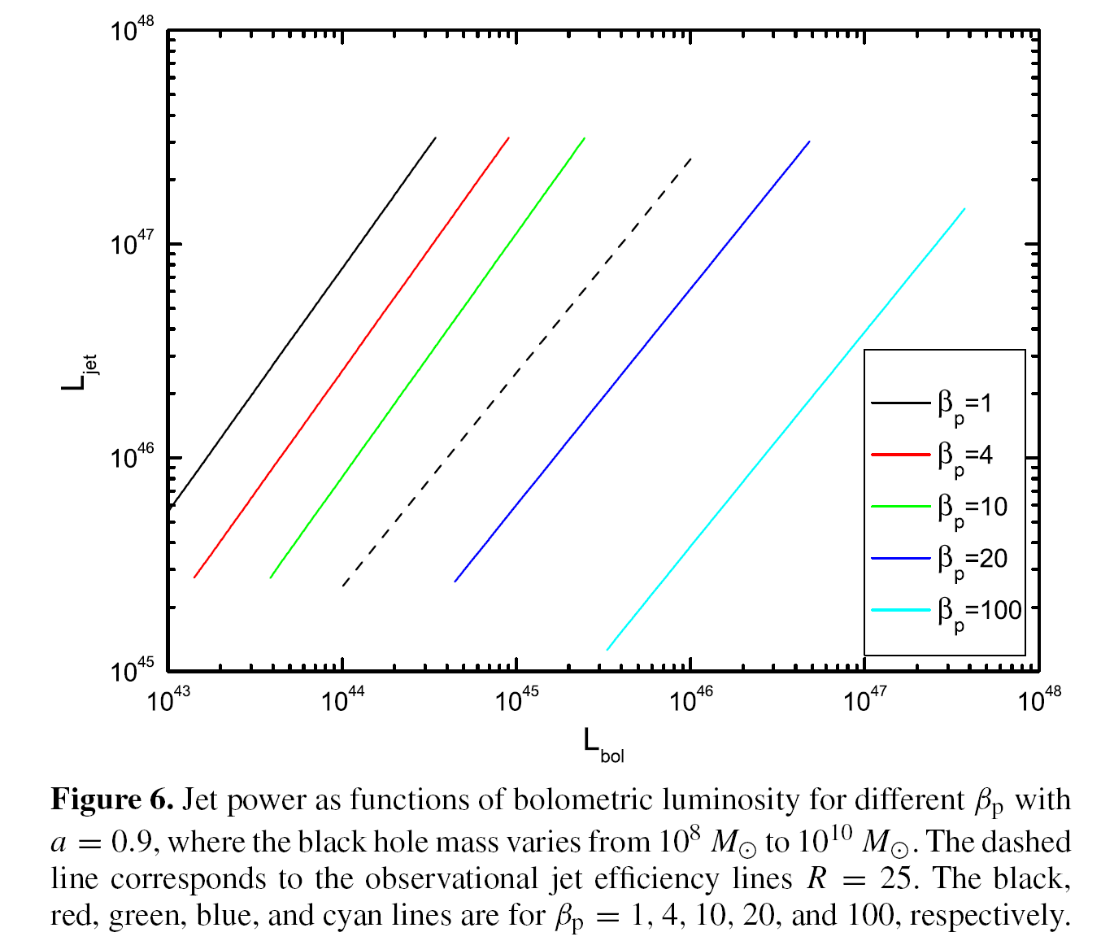

Slide 14
4 CONCLUSIONS AND DISCUSSION
1. According to our model, the reason for the high jet efficiency could be that most of released gravitational energy in the disk is carried away by jets, which results in the very low radiative efficiency.
2. A theoretical maximum jet efficiency R ~ 1000 is found in this work, which is adequate even to take the episodic activity of jets into account.
3. Compared with the observational results, our study indicates that 10 < β_{p} < 20 is required for α = 0.1 and B_{φ} = 0.1B_{p}.

Slide 15
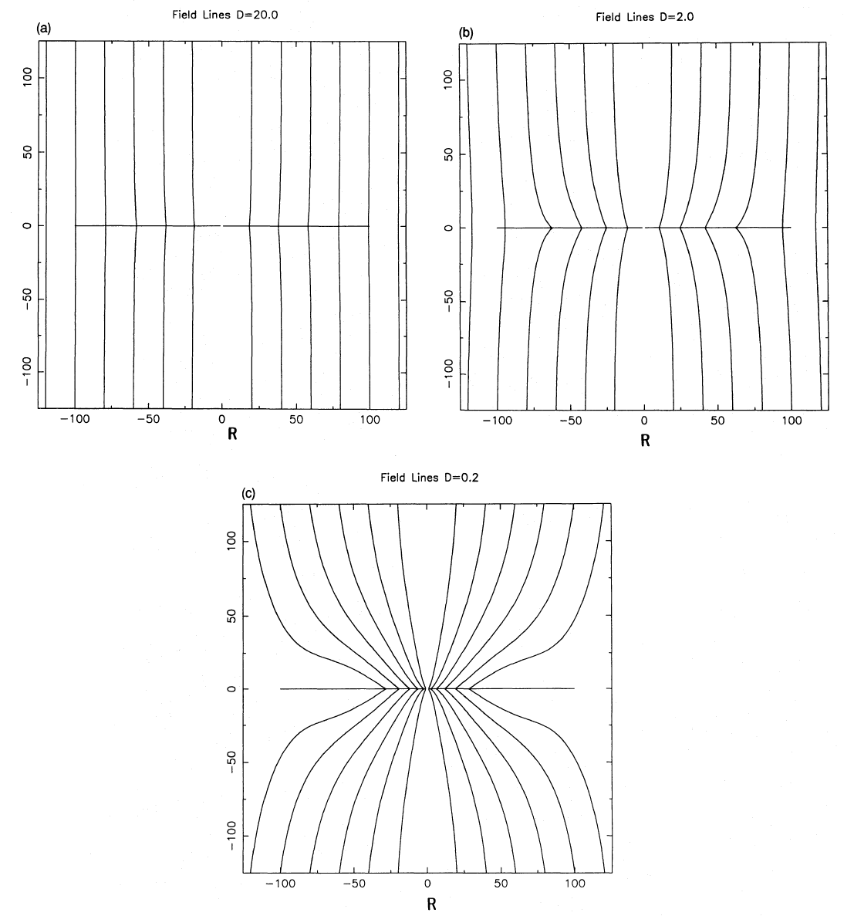
Lubow et al. (1994)
Spurit & Uzdensky (2005), field bundles
Cao & Spruit (2013), Li & Begelman (2014), large scale magnetic fields
Thin disk
Thick disk

Slide 16
Thanks!

