Slide 1
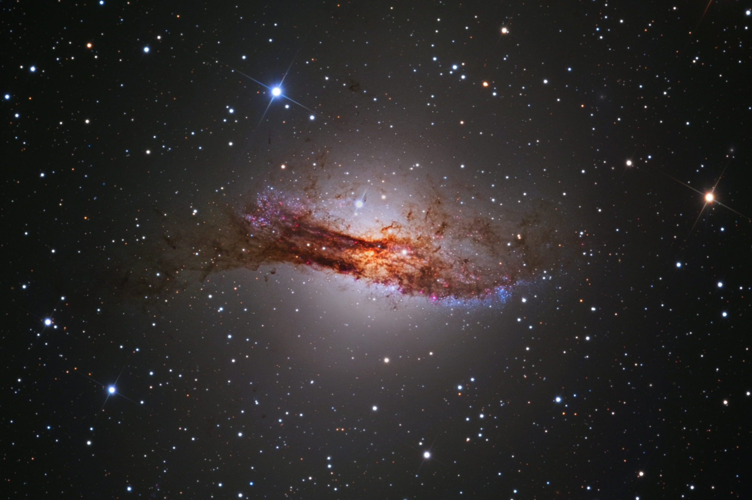
The Energetic Particle Population in Centaurus A
A.M. Brown¹, C.M. Boehm^{1,2}, J.A. Graham¹, T. Lacroix³,
P.M. Chadwick¹, J. Silk^{3,4}
¹Durham University, UK; ²LAPTH, U. de Savoie, France; ³Institut d’Astrophysique de Paris; ⁴ Johns Hopkins University, USA
Image: SSRO-South (Steve Mazlin, Jack Harvey, Daniel Verschatse, Rick Gilbert) and Kevin Ivarsen (PROMPT/CTIO/ UNC)

Slide 2
Why Cen A?
SMBHs in AGN may induce a DM ‘spike’, resulting in an increased gamma-ray flux (Lacroix et al., 2015)
DM annihilation products may be an important source of seed particles for cosmic rays (Davis et al., 2015)
Expect to see some kind of ‘bump’ or feature in the spectrum at HE
Cen A is a good candidate object:
  Close (no significant EBL absorption)
  Bright at HE (good stats)
  Not known to be highly variable on short timescales
  Hint of a feature seen earlier (Sahakyan et al., 2013)

Slide 3
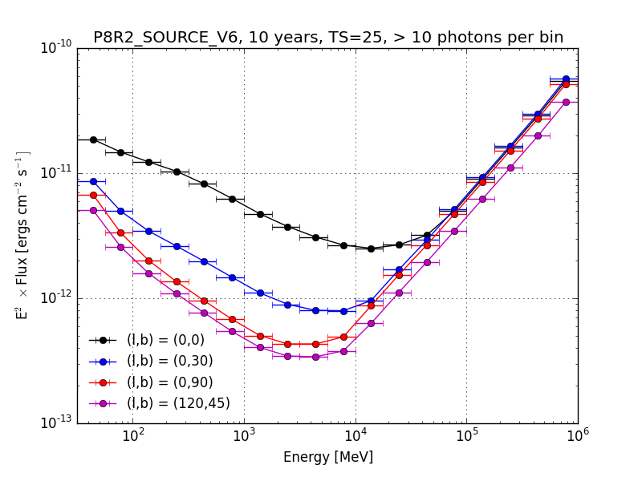
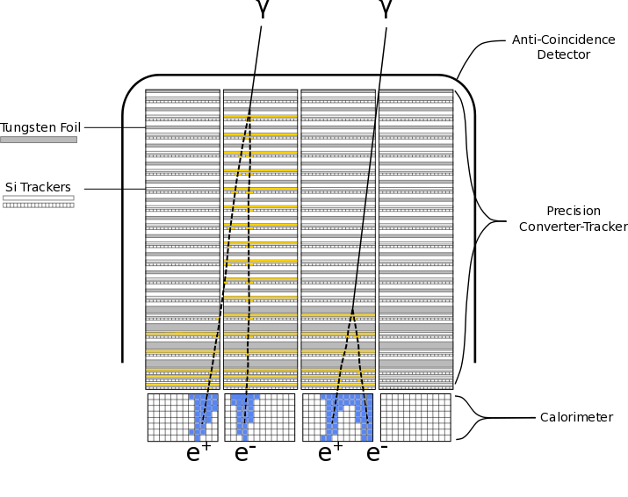
Fermi-LAT
A quick refresher!
Launched 11th June 2008 – Gamma Ray Burst Monitor (GBM) and Large Area Telescope (LAT)
Most recent data release is Pass 8 version 6. We use 8 years of data from 100 MeV to 300 GeV.
Tom Armstrong
Covers the whole sky once every ~3 hours.
See http://www.slac.stanford.edu/exp/glast/groups/canda/lat_Performance.htm for details.

Slide 4
Cen A with Fermi-LAT
L to R: All 0.1-2.4 GeV photons; model map; residuals map in %, showing no contamination by ‘extra’ sources
We are interested in the core – lobes also modelled out.

Slide 5
South-North and West-East ‘slices’ across the counts map.

Slide 6
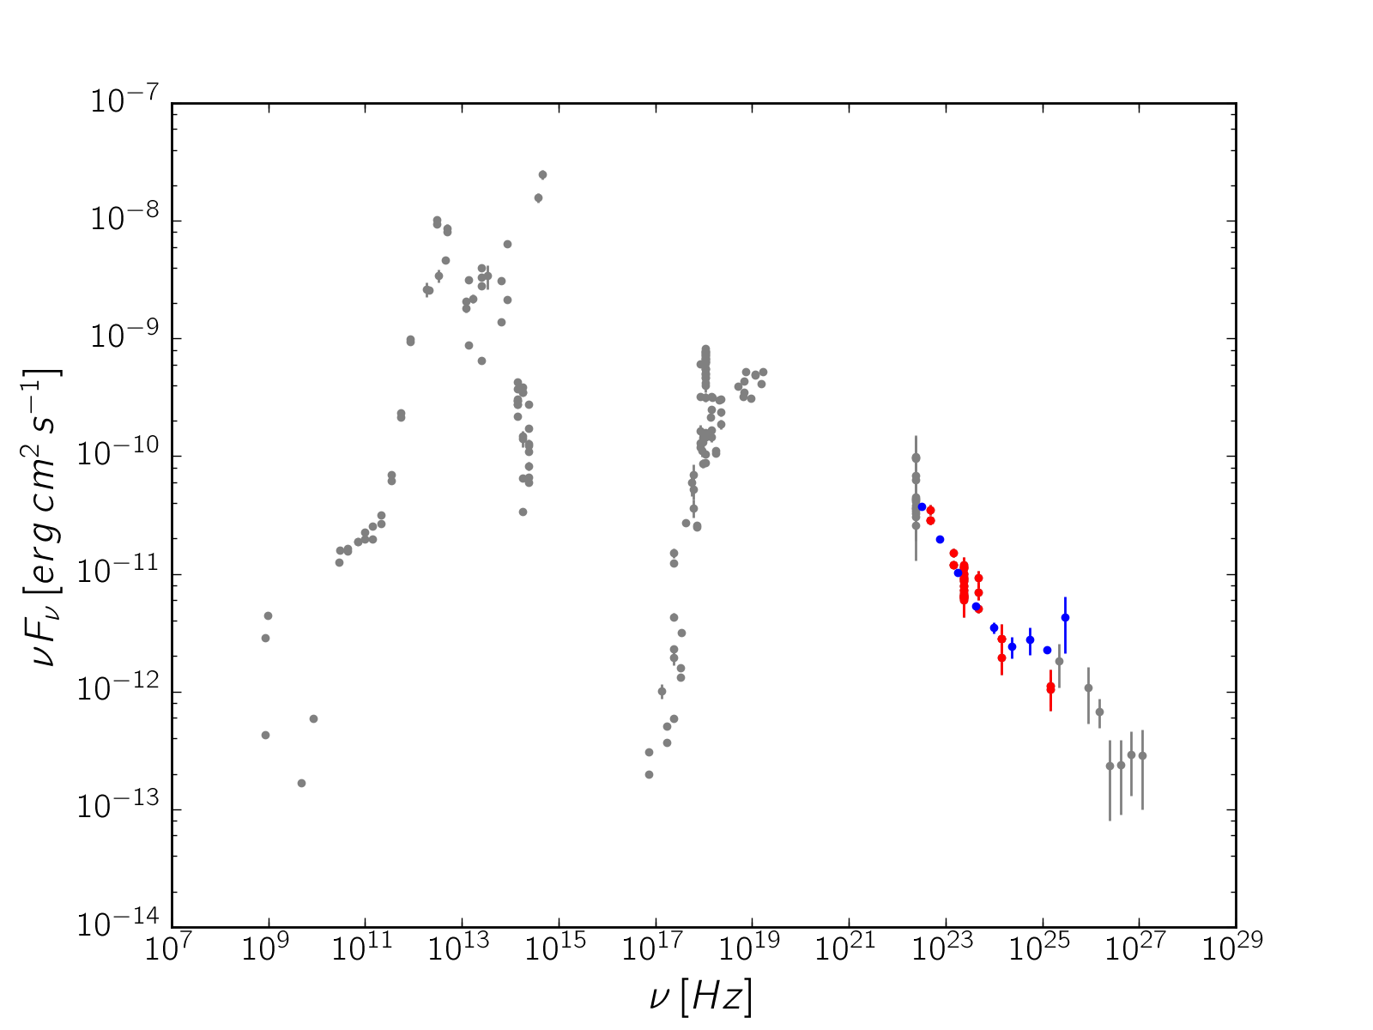
Broadband SED

Slide 7
Fermi Spectrum
TS = -2Ln(L_{max,0}/L_{max,1}); sqrt(TS) ~ significance

Slide 8
Fitting the Break
Break is significant at the > 5σ level
Model | Norm (MeV cm⁻² s⁻¹) | Shape Parameters | Break Energy (GeV) | TS (c.f. PL)
Power Law | (4.36 ± 0.06) x 10⁻⁹ | γ = 2.69 ± 0.01 | N/A | 0
Broken Power Law | (4.2 ± 1.4) x 10⁻¹¹ | γ₁= 2.73 ± 0.02 γ₂ = 2.29 ± 0.07 | 2.6 ± 0.03 | 28.600
Log Parabola | (4.16 ± 0.08) x 10⁻¹¹ | α = 2.7 ± 0.01 β = -0.040 ± 0.009 | N/A | 16.637

Slide 9
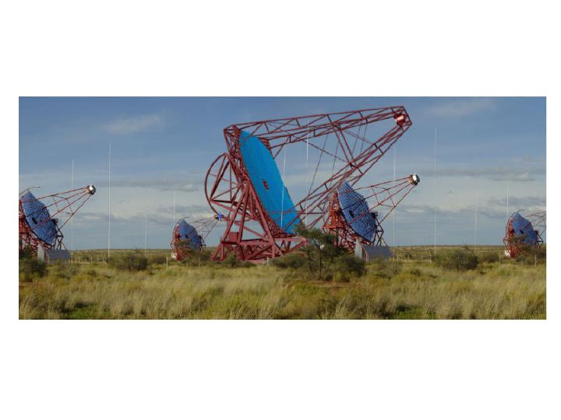
What about Higher Energies?
There are results from H.E.S.S. from 2009 – before the large (H.E.S.S. II) telescope was built.

Slide 10
Adding Ground-based (H.E.S.S.) Points
Aharonian et al., 2009 – new results expected very soon (this week)!

Slide 11
Variability (or not)
0.1 < E < 2.6 GeV
2.6 < E < 300 GeV
Low E: ~ 1.7σ (but note before MJD 56000) High E: ~ 2.2σ

Slide 12
Possible Causes
Single zone leptonic jet model?
Leptohadronic model ?
  See, e.g., Petropolou et al., 2013
  Spectral hardening due to synch. Emission from leptonic by-products of hadronic interactions
  Variability of the HE component similar to LE expected
Dark matter?
Millisecond pulsar population?

Slide 13
Dark Matter?
Assuming no re-acceleration of DM decay products
NFW distribution and thermal cross-section of σv = 3 x 10⁻²⁶ cm³s⁻¹ is strongly disfavoured. However, our X-section is too small to explain all the DM - rich dark sector or velocity dependent X-section is required. Spiky DM profile as in Gondolo & Silk (1999).

Slide 14
Millisecond Pulsars?
Electron-positron pairs create GeV feature, broadened up to TeV energies via inverse Compton (Bednarek & Sobczak, 2013). Critical assumptions: electron injection spectrum to a few 10s of TeV and a suitable interstellar radiation field for IC.

Slide 15
A Bit of Both?

Slide 16
Conclusions
There is a clear break in the Cen A spectrum at around 2.5 GeV
This is not consistent with a single zone leptonic acceleration model (no surprise there)
Interpretations could include DM or MSPs (or a combination) – or leptohadronic models?
We need CTA…
Hvàla!

Slide 17
Backup slides

Slide 18
Analysis Criteria

Slide 19
Goodness-of-fit
For DM:
χ² = 1.7 (0.24 per d.o.f., so error-dominated)
For MSPs:
χ² = 10 (1.4 per d.o.f)
Combination does not improve this much

